Slide 1


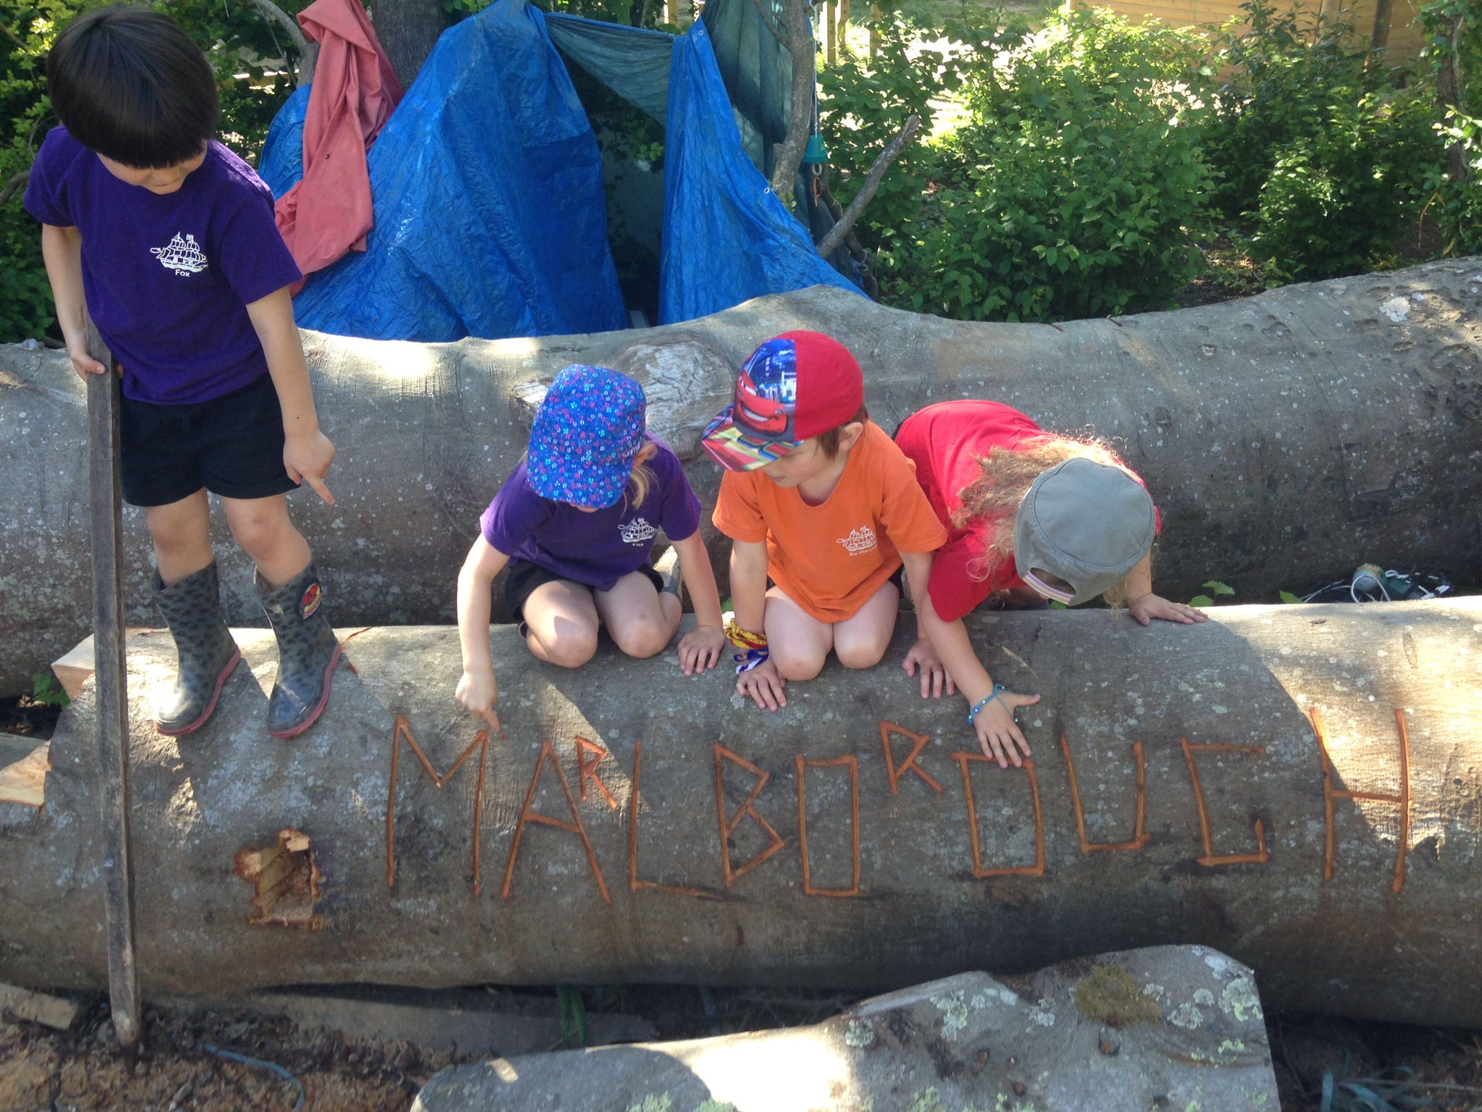
Marlborough School
Starting in Reception Class 2021

Slide 2


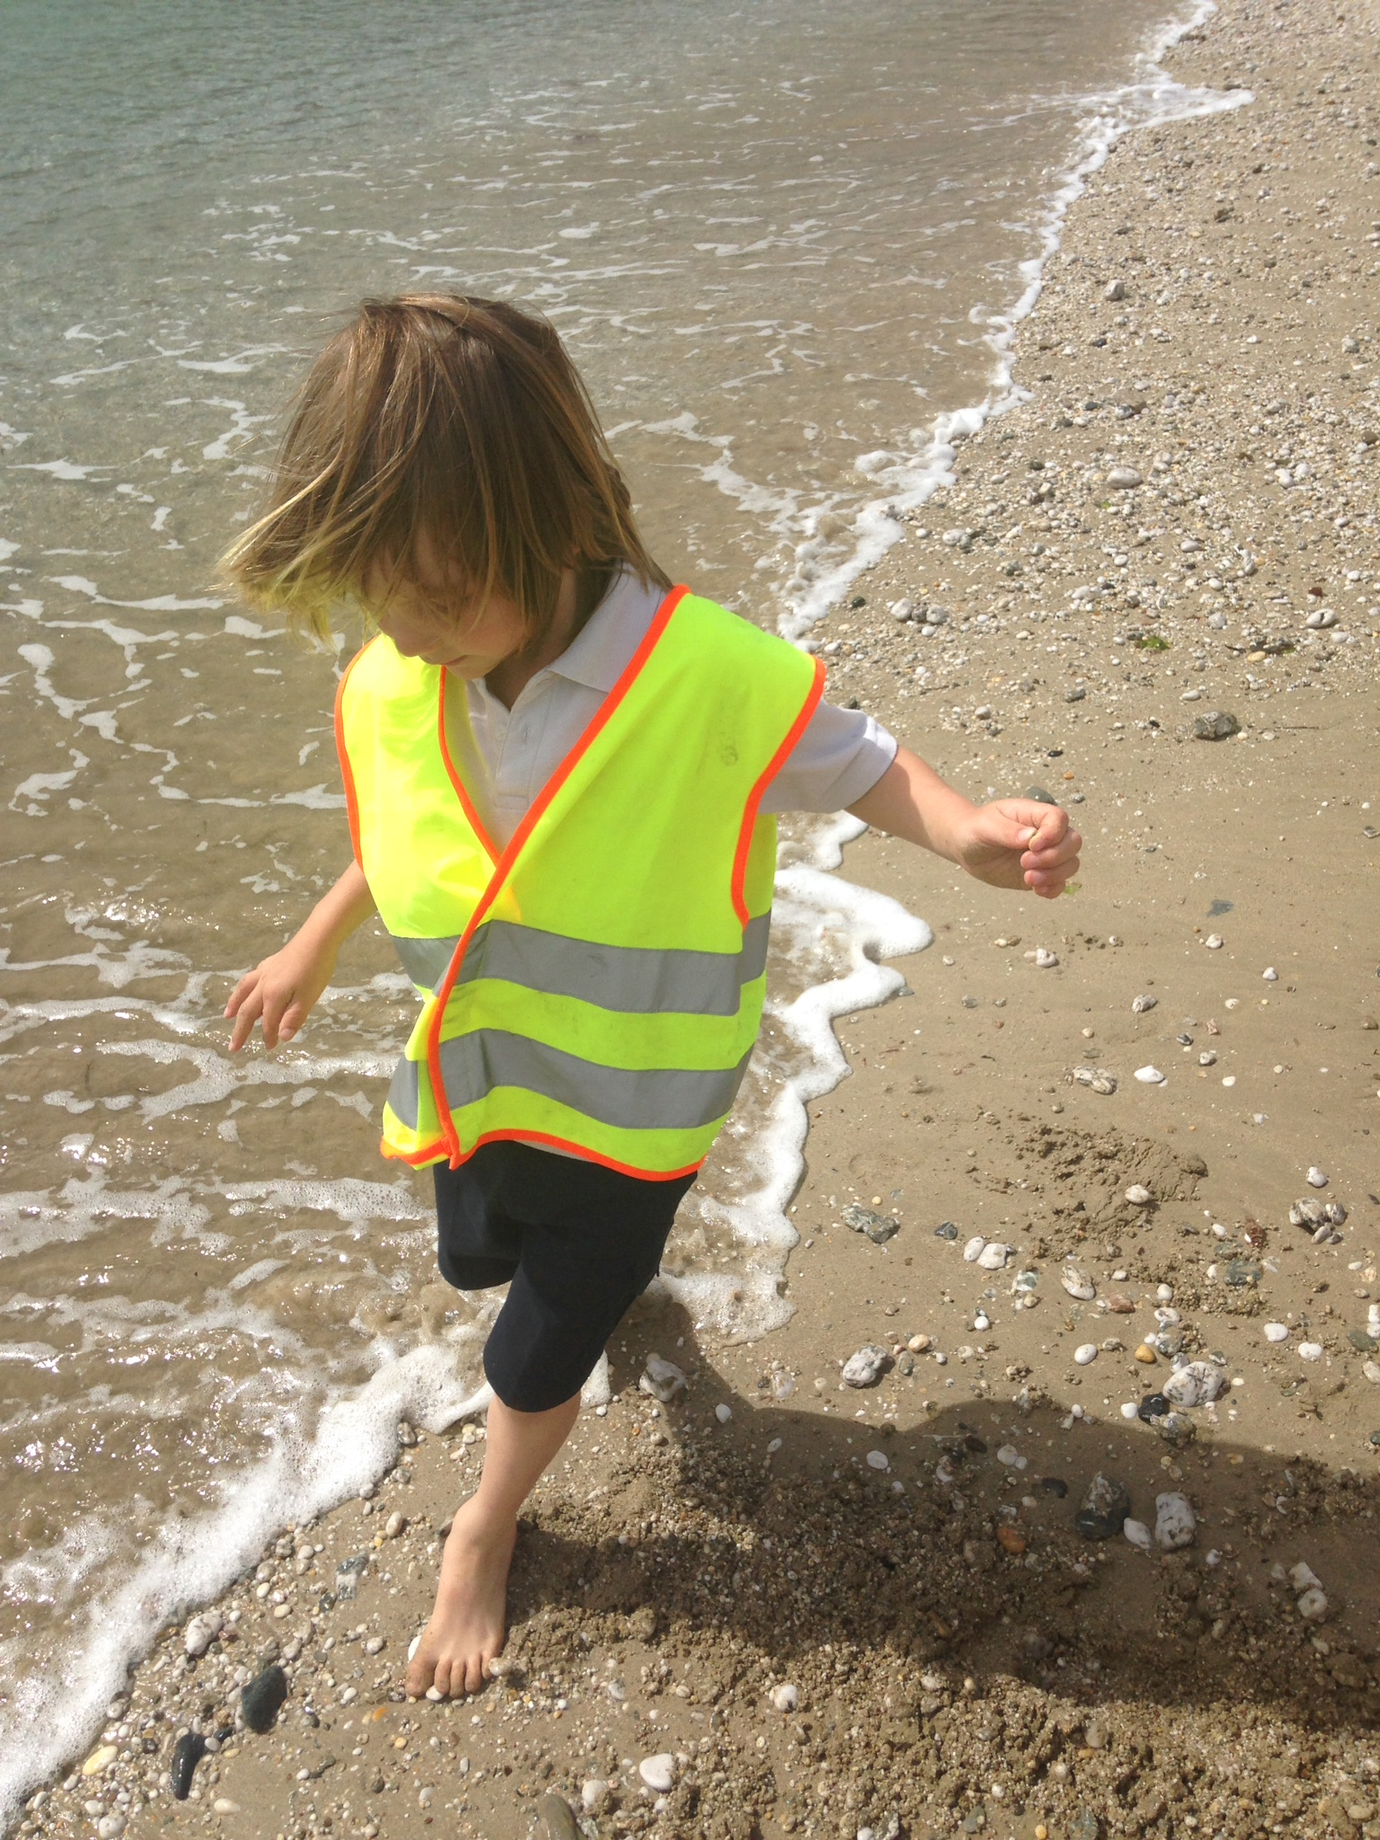
Marlborough School
Who is who?
Teaching Team
Which Packet Ship?
Marlborough Manners
Practicalities
School Meals

Slide 3
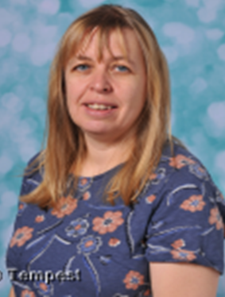
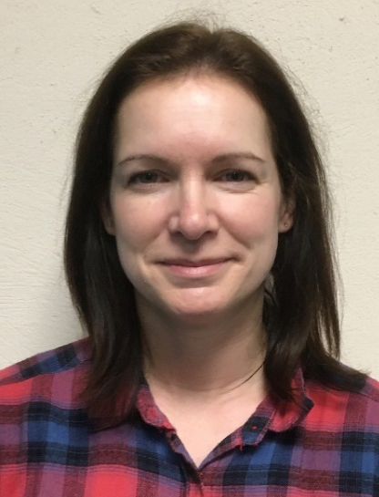
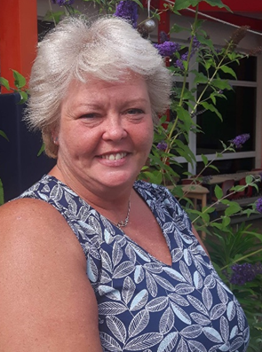

Marlborough School
Teaching Team
Mrs Lisa Pearce
Mrs Becky Prason
Teaching Assistants:
Mrs Shirley Burley
Miss Jenny Hart

Slide 4
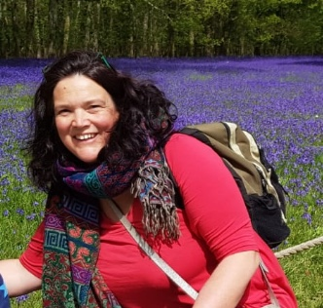
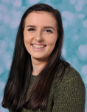

Marlborough School
Other people you will meet…
Miss Abigail Squibb
Headteacher
Miss Olivia Pentecost
Mr Kieran Jenkin
School Secretary
School Secretary

Slide 5

Marlborough School
Which Packet Ship?

Slide 6
Marlborough School
Which Packet Ship are you in?
Walsingham
Laurie
Wilf
Harry S
Rowan
Max
Pelham
Yorke
Braydon
Lyra
Daisy
Lily
Freeling
Levan
Ivy
Audrey
Wilkie
Teddy
Chichester
Evie
Lucy
Felix
Ollie
Lenny
Swiftsure
Amelia
Orla
Ruben
Sonny
Megan
Fox
Arlan
Harry H
Jessie
Avalon
Julen

Slide 7

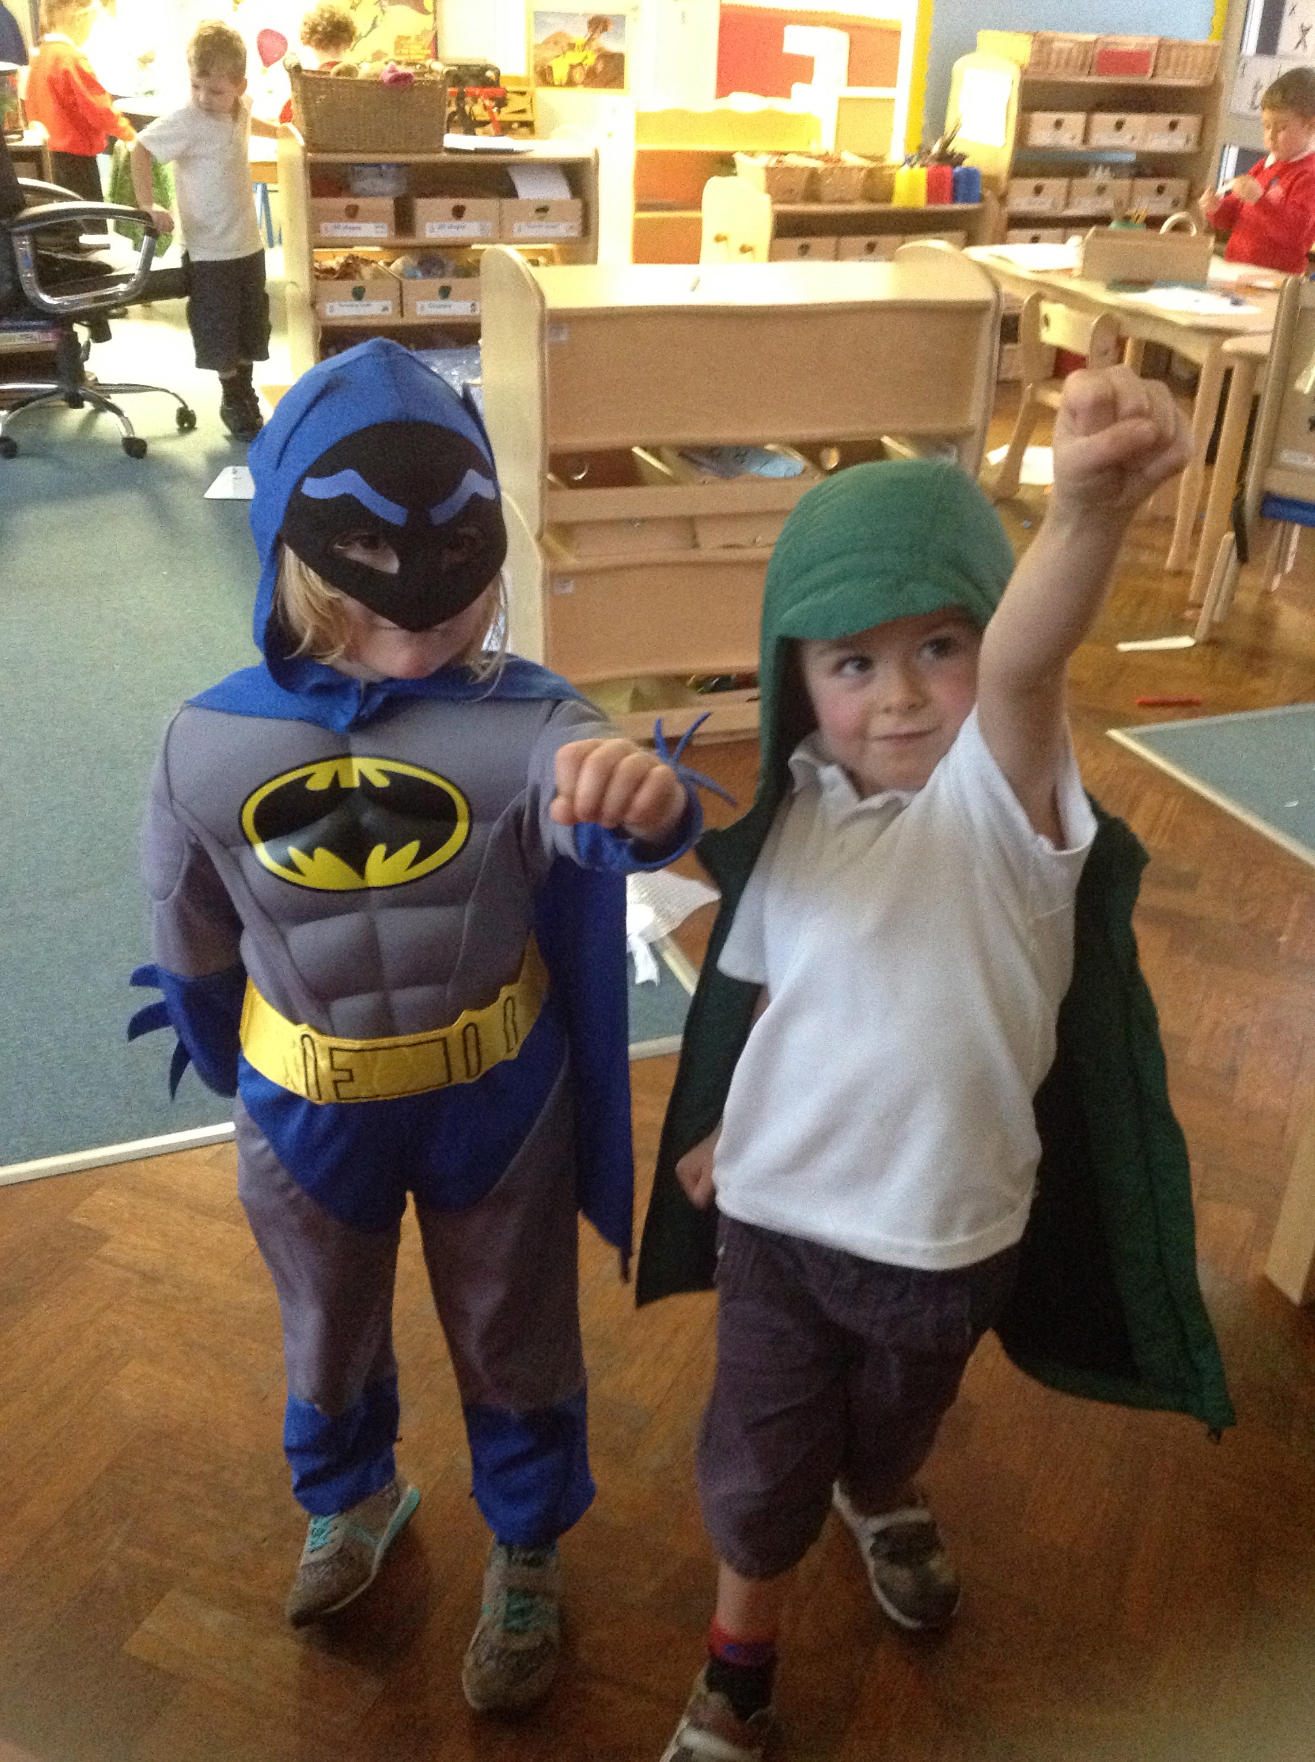
Marlborough School
Marlborough Manners for all
Show good manners all the time
Take care of everyone and everything
Follow all instructions with attention and thought

Slide 8
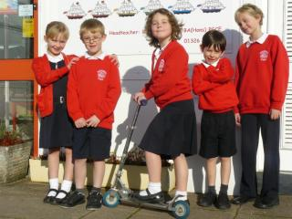
Marlborough School
Starting at Marlborough…
Dress Code
Look at how smart our children are!
Have a look at our website for our further details about our
dress code and suppliers. https://marlborough.eschools.co.uk/website/dress_code/465790
As children start school we want them to become independent so please bear this in mind when making school uniform purchases, especially shoes!

Slide 9
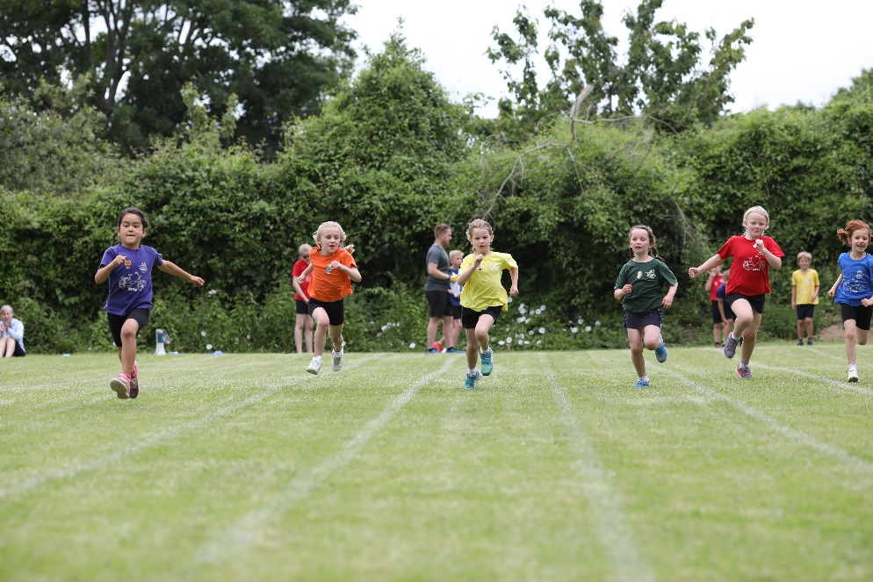


Marlborough School
Starting at Marlborough…
PE kit
Children will need a PE kit, with their names on each item of clothing. This consists of a Packet Ship t-shirt and black shorts.
Children will not need swimming costumes yet.
Please can children have labelled wellies in school.
https://marlborough.eschools.co.uk/website/dress_code/465790

Slide 10
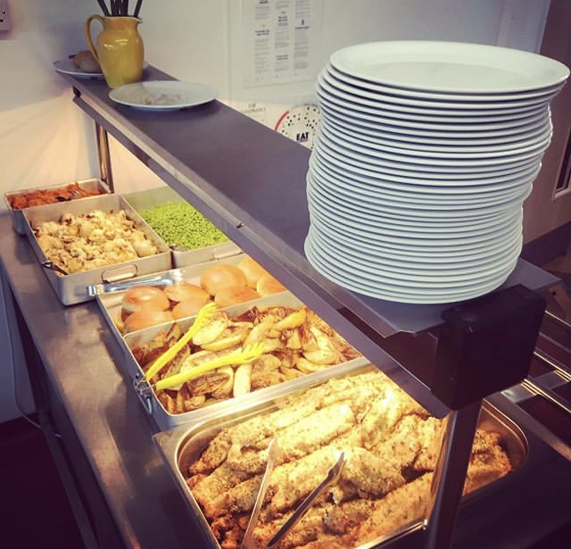
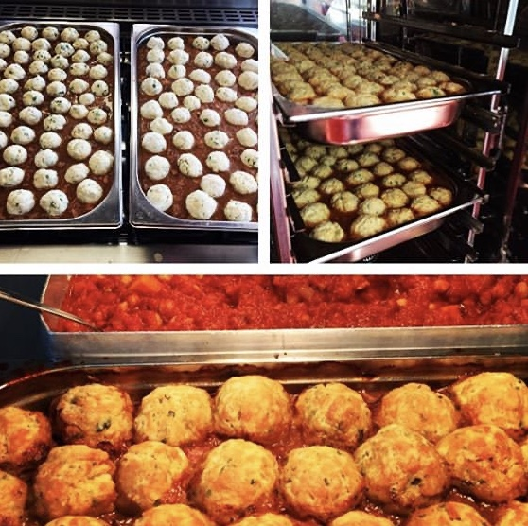
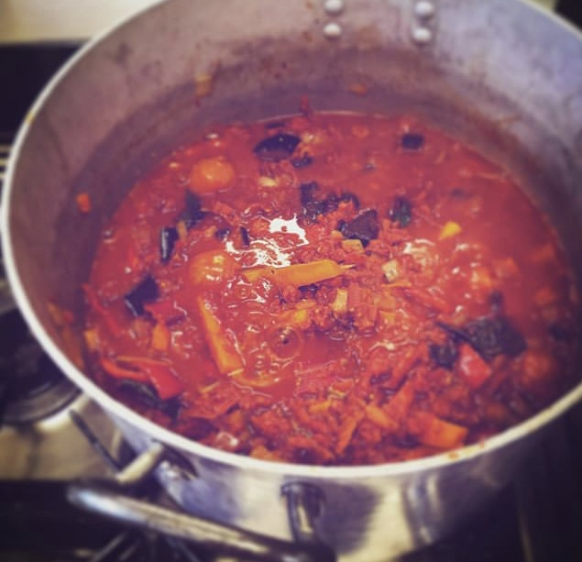
Marlborough School
Starting at Marlborough…
Universal Free School Meals for Infants
All of the children in Reception, Year 1 and Year 2 have delicious school lunches provided free of charge.
Children eat in the school hall at round tables, using knives and forks and with adults supervising them.
Our kitchen can cater for individual dietary needs, just talk to Mrs Pearce or Mrs Prason before your child starts school.
We require lunches to be pre ordered online via Parent Pay, the office will send home your log in details during the first week of school.

Slide 11
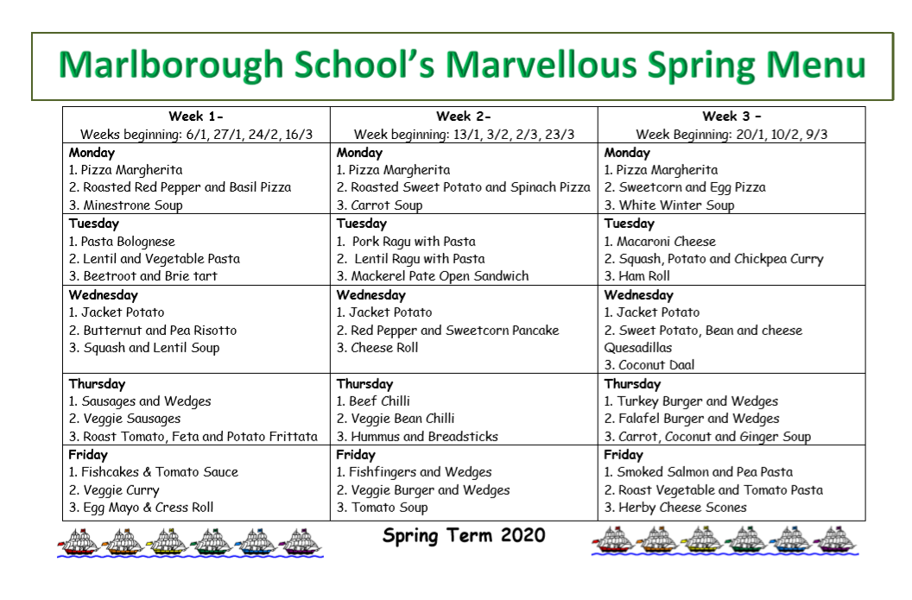
Marlborough School
Example Menu

Slide 12

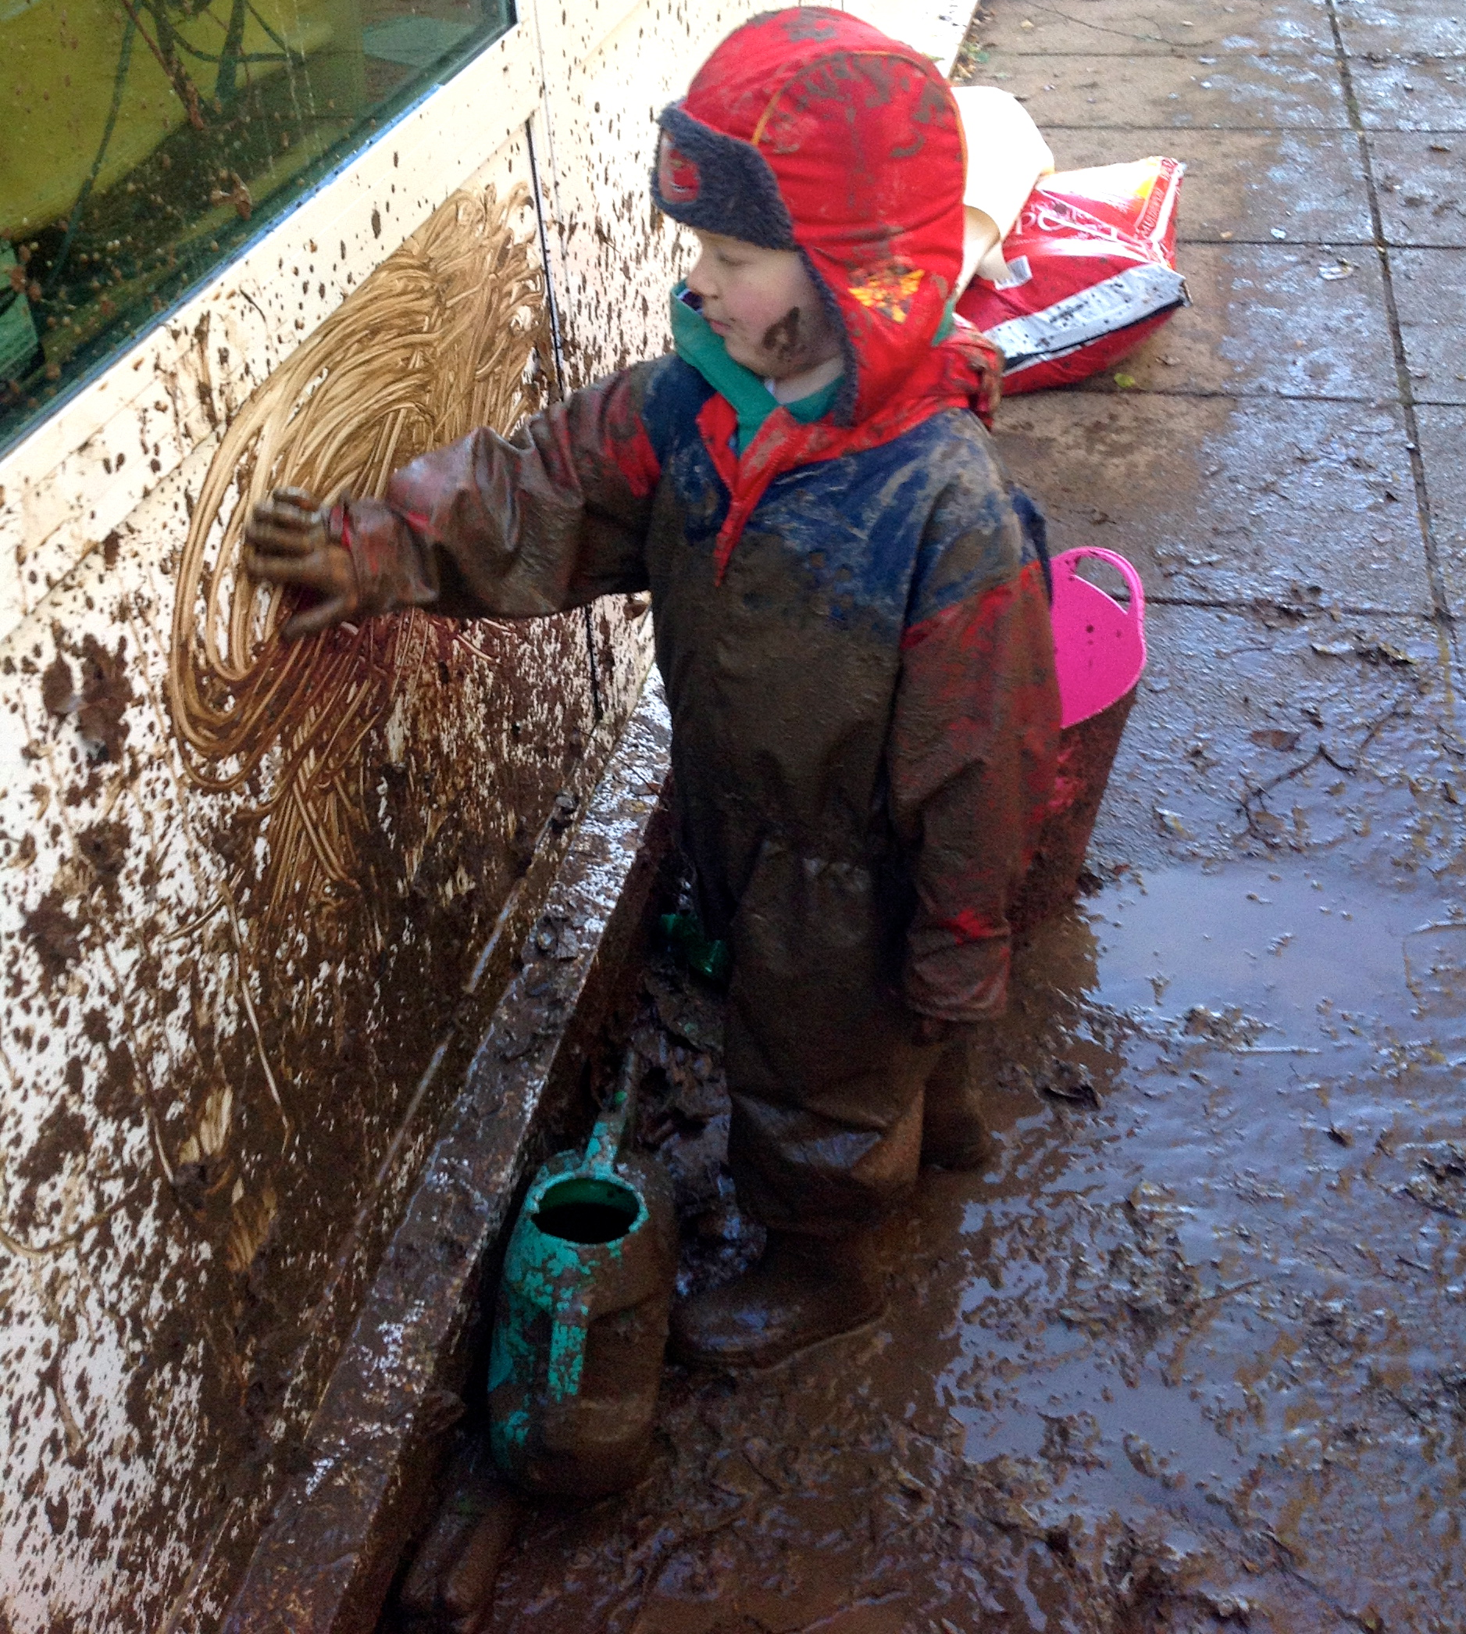
Marlborough School
Starting at Marlborough…
Practical Personal Skills
It is really important that your children becomes independent with many aspects of school life. In order to support them with this it would be helpful if children were able to use a knife and fork, get themselves dressed and undressed for PE and be independent when going to the toilet.
If you have any worries about this aspect of starting school please talk to Mrs Pearce or Mrs Prason.

Slide 13
Marlborough School
Timings
Aspects of school life are different due to Covid-19 and there are many precautions we have put into place. What these precautions look like come September all depends on the latest government guidance.
At present the classroom door will be open from 8.30 until 8.45; we will give you more information on dropping your children off nearer the time as we receive the safety updates.
Lunch for the reception children will be at 11:30am.
The school day ends at 3.20pm. On Fridays school finishes at 1:50pm.
Parents wait at a distance from the classroom door for their child to come out.

Slide 14
Marlborough School
Pupil Premium Funding
A child’s family circumstances are taken into account when determining whether or not they qualify for free school meals. To be eligible, they must be receiving one or more of the following benefits:
Income support
Income-based Jobseeker’s Allowance
Income-based Employment and Support Allowance
Support as a result of the Immigration and Asylum Act 1999
Pension Credit
Child Tax Credit
Working Tax Credit
Universal Credit (if a household is earning less than £7,400 per year)
It’s also worth noting that if a child receives these benefits directly, rather than a parent or guardian, they are also entitled to free school meals. This can be the case if the child is in care or some form of guardianship programme.

Slide 15
Transition Sessions
We will be holding a transition session this term for each child to enable them to come into school, explore their new classroom and get to know the new adults. The children will be in small groups, and you are welcome to stay or once your child is settled and happy you can leave them.
Due to the delay in easing COVID restrictions adults will be able to stay in the outdoor woodland area but will unfortunately not be allowed in the classroom as we had hoped.
Friday 25th June, 2.30pm-3.30pm - Freeling and Pelham.
Friday 2nd July, 2.30pm-3.30pm - Fox and Chichester.
Friday 9th July, 2.30pm-3.30pm - Swiftsure and Walsingham.

Slide 16

Transition Phone Calls
Lisa Pearce will be making phone calls to parents before the end of the summer term.
These are replacing home visits due to Covid restrictions.
Lisa will be offering these on:
Thursday 8th July - all day
Friday 9th July – am
Friday 16th July – am
An email will follow allowing you to book a slot for the sessions.

Slide 17
Marlborough School
Transition
In order to settle the children in to school life we will have transition sessions, where children start in smaller groups during the first two weeks of September.
 | Tues 7th Sept | Wed 8th Sept | Thurs 9th Sept | Fri 10th Sept | Monday 13th Sept | Tues 14th Sept | Wed 15th Sept | Thurs 16th Sept | Fri 17th Sept | Mon 18th Sept
Morning Session 8.30-11am | Swiftsure Walsingham Fox | Swiftsure Walsingham Fox | Swiftsure Walsingham Fox | Swiftsure Walsingham Fox | Swiftsure Walsingham Fox | Chichester Pelham Freeling | Chichester Pelham Freeling | All children- 12pm pick up | All children stay for the morning | All children stay for the morning and stay for lunch - 1pm pick up
Afternoon Session 12.50-3.20 | Chichester Pelham Freeling | Chichester Pelham Freeling | Chichester Pelham Freeling | Chichester Pelham Freeling | Chichester Pelham Freeling | Swiftsure Walsingham Fox | Swiftsure Walsingham Fox

Slide 18



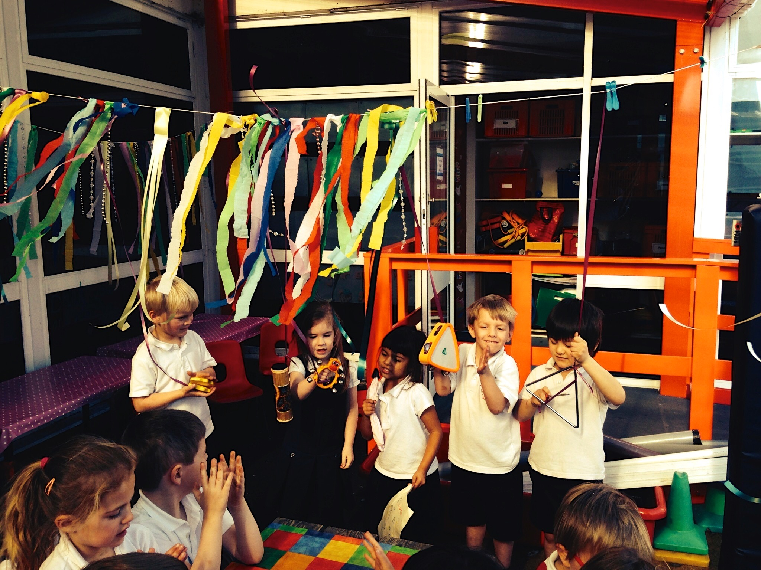
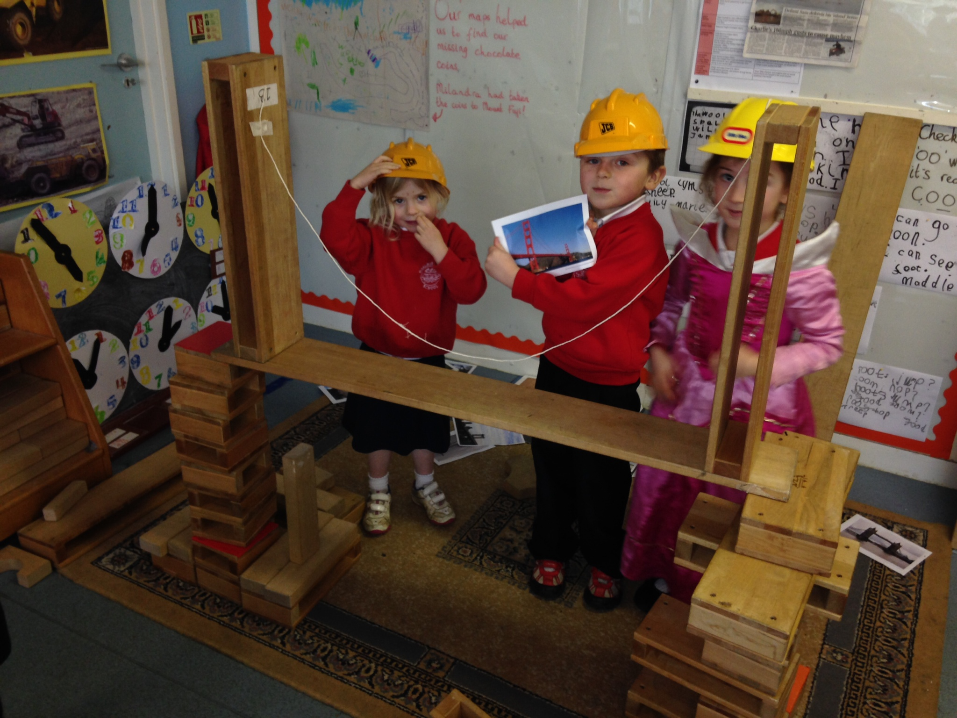
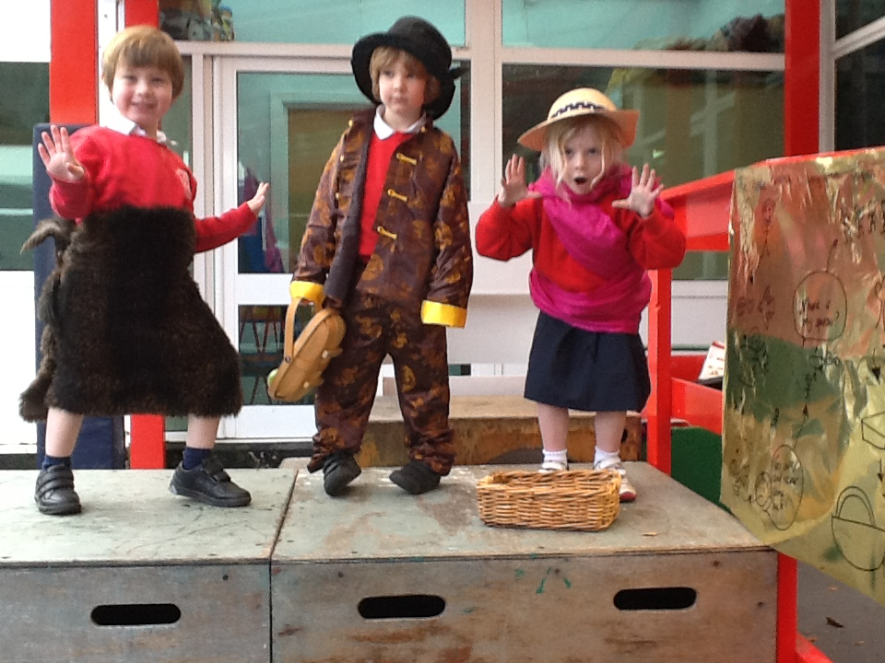
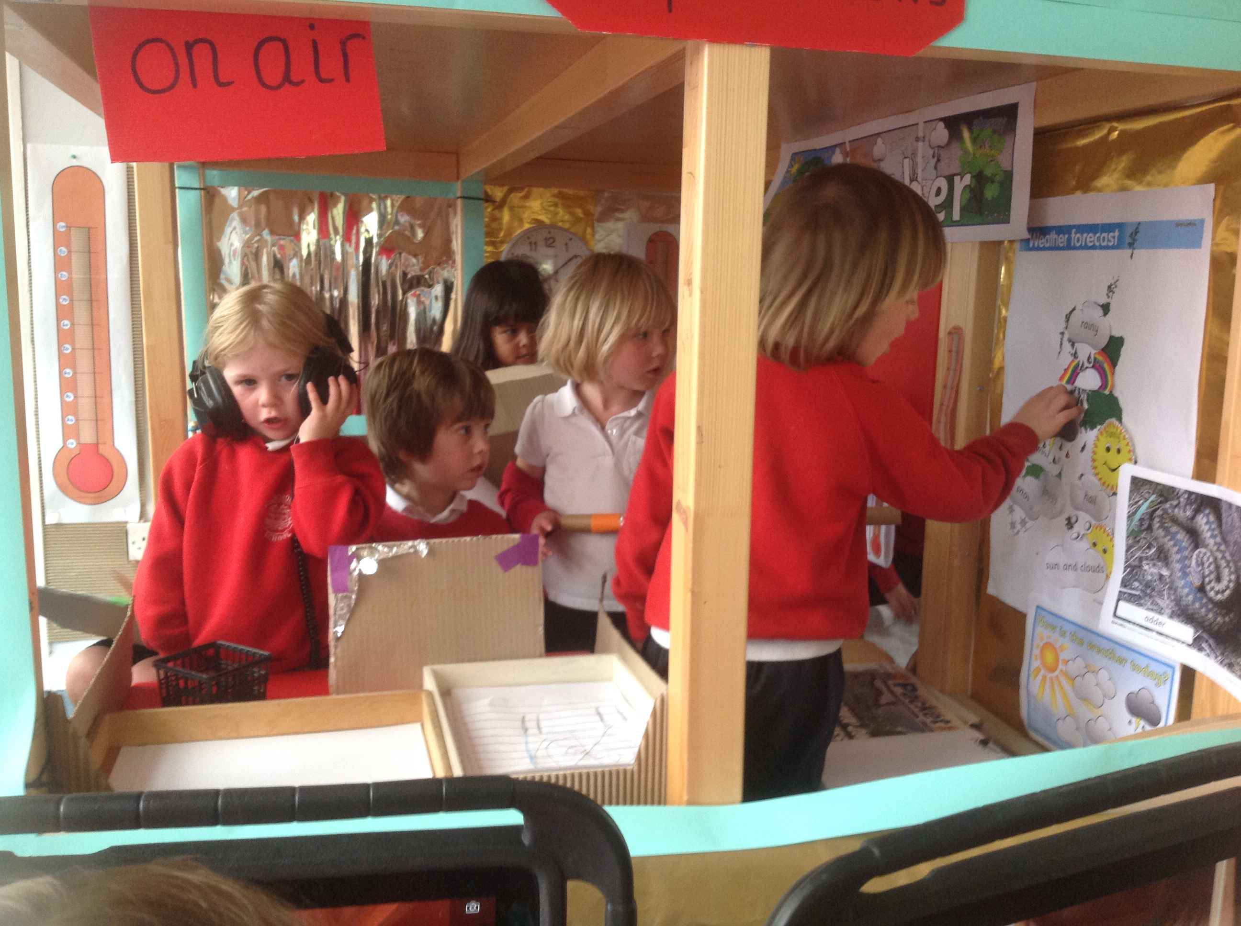




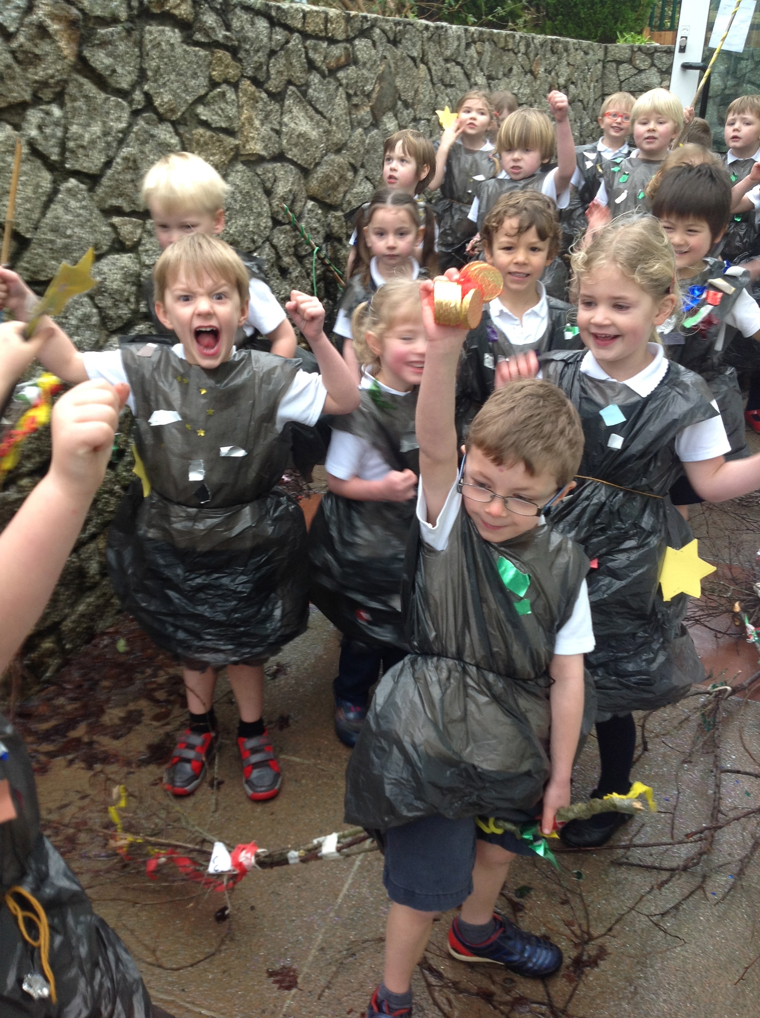
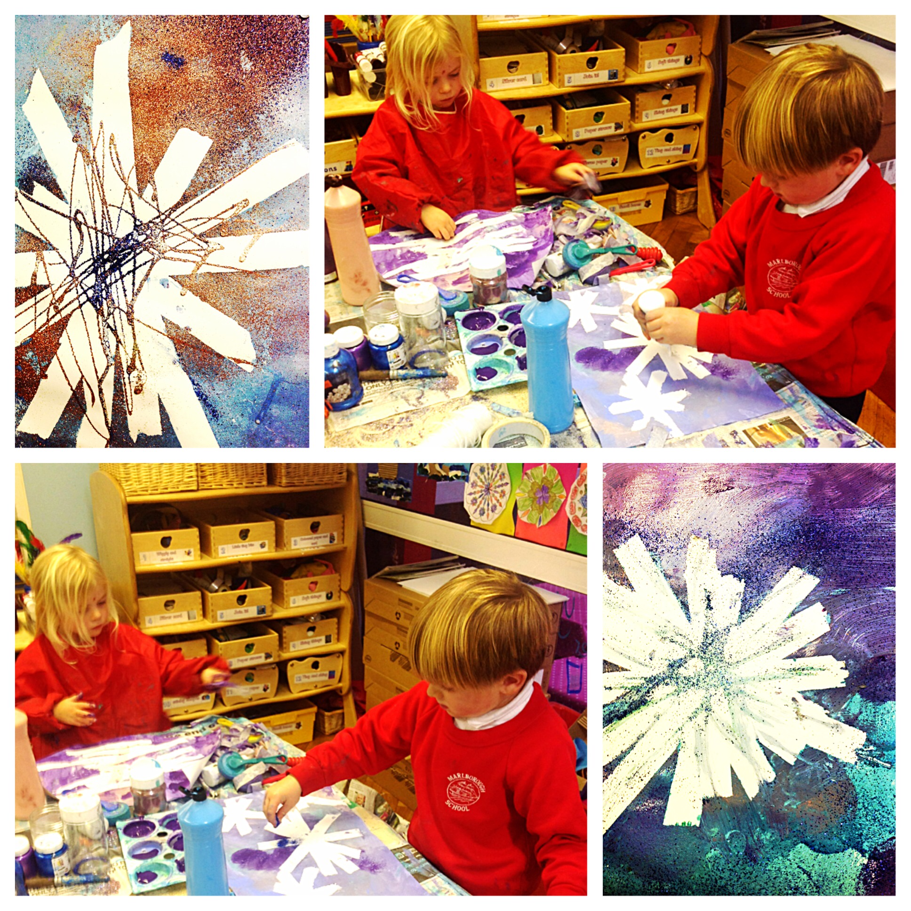
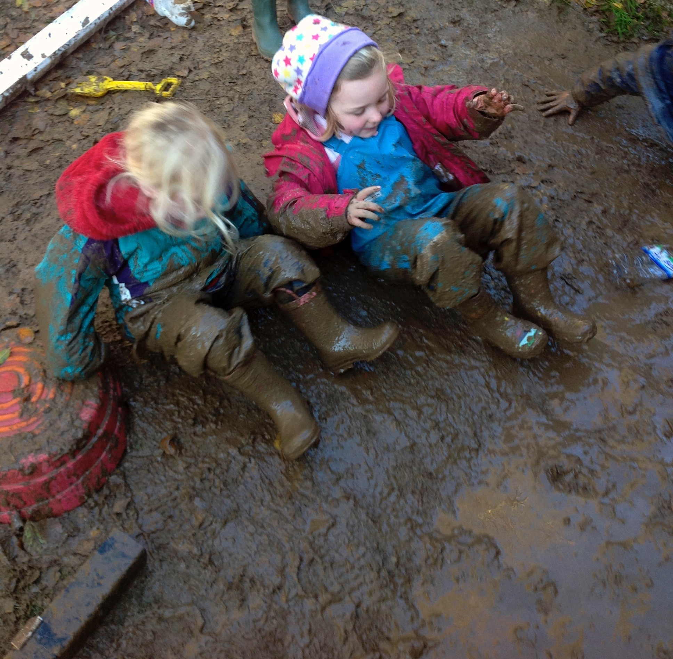
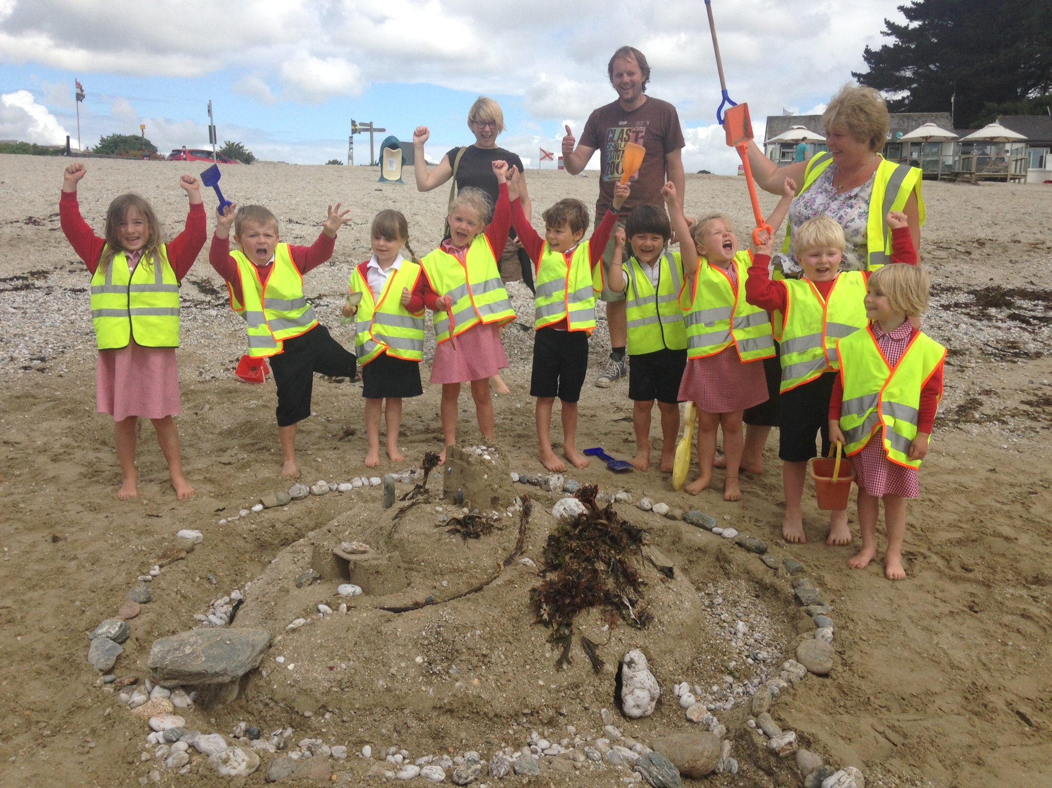
Marlborough School
What is it like to be in Reception Class at Marlborough School?
https://vimeo.com/68252354
https://vimeo.com/127502097
Notes:
https://vimeo.com/68252354

Slide 19
Marlborough School
Have a look at our school website for newsletters, information, updates and policies.
https://marlborough.eschools.co.uk/website
Notes:
https://vimeo.com/68252354

Slide 20
Marlborough School
A Rising Tide Lifts All Ships
We’re looking forward to seeing you in person!

