Slide 1
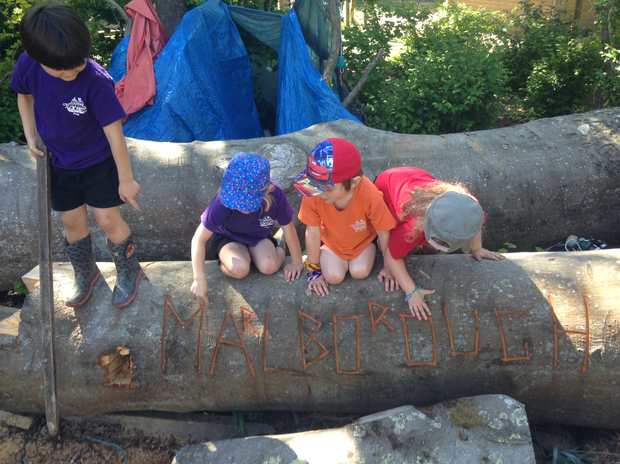
Marlborough School
Starting in Reception Class 2020

Slide 2
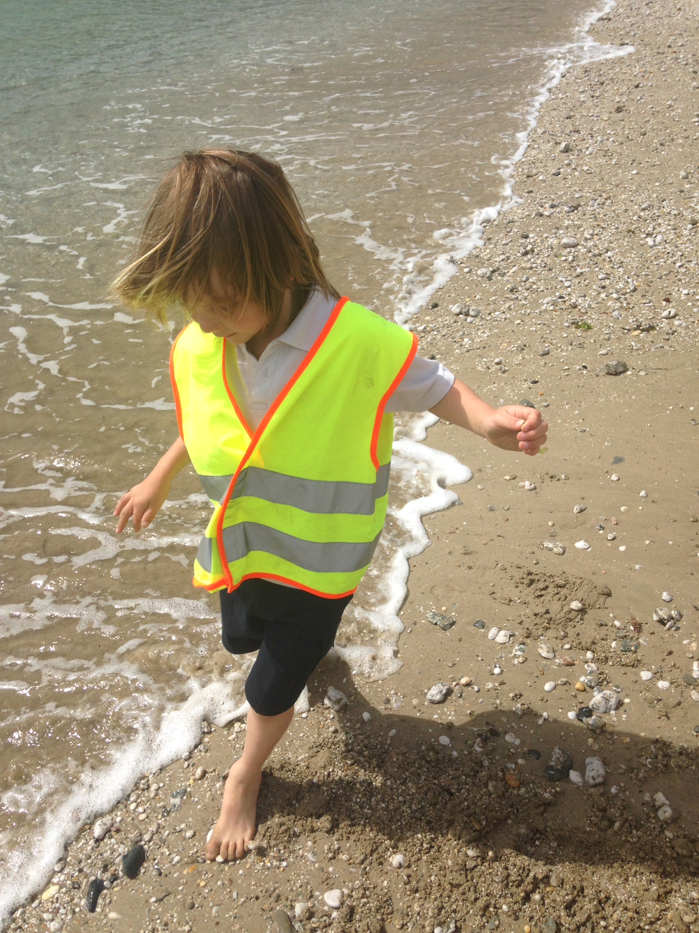
Marlborough School
Who is who?
Teaching Team
Which Packet Ship?
Marlborough Manners
Practicalities
School Meals

Slide 3
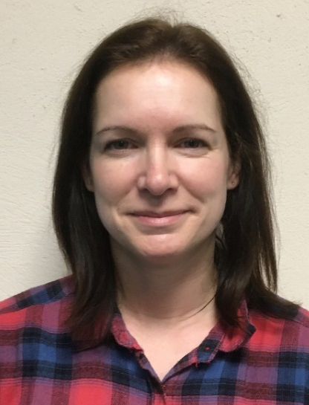
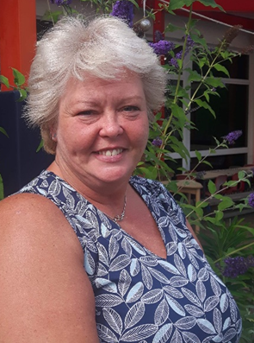
Marlborough School
Teaching Team
Mrs Lisa Pearce
Mrs Becky Prason
Teaching Assistants:
Mrs Shirley Burley
Miss Jenny Hart

Slide 4
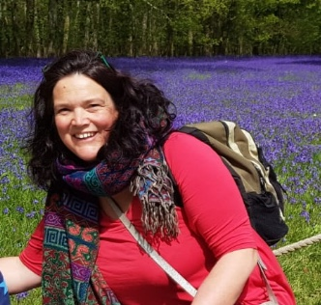
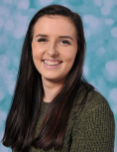
Marlborough School
Other people you will meet…
Miss Abigail Squibb
Headteacher
Miss Olivia Pentecost
Mr Kieran Jenkin
School Secretary
School Secretary

Slide 5
Marlborough School
Which Packet Ship?

Slide 6
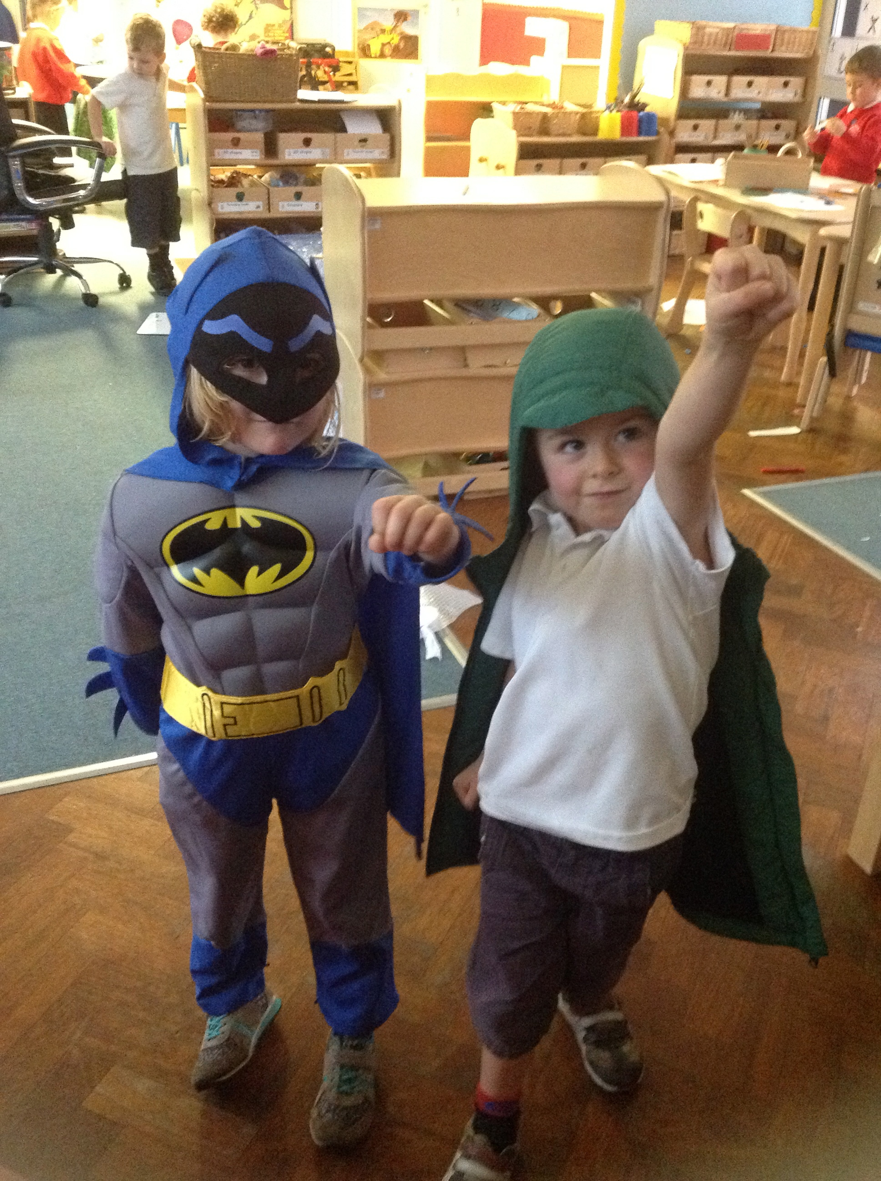
Marlborough School
Marlborough Manners for all
Show good manners all the time
Take care of everyone and everything
Follow all instructions with attention and thought

Slide 7
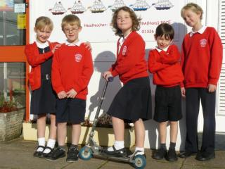
Marlborough School
Starting at Marlborough…
Dress Code
Look at how smart our children are!
Have a look at our website for our further details about our
dress code and suppliers. https://marlborough.eschools.co.uk/website/dress_code/465790
As children start school we want them to become independent so please bear this in mind when making school uniform purchases, especially shoes!

Slide 8
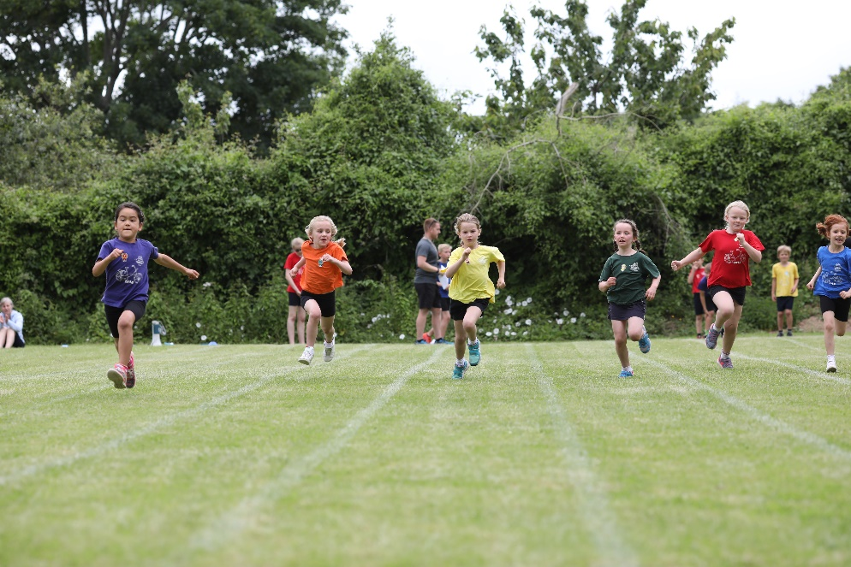
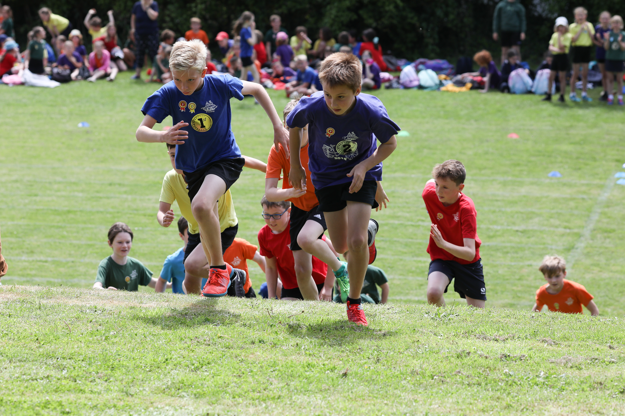
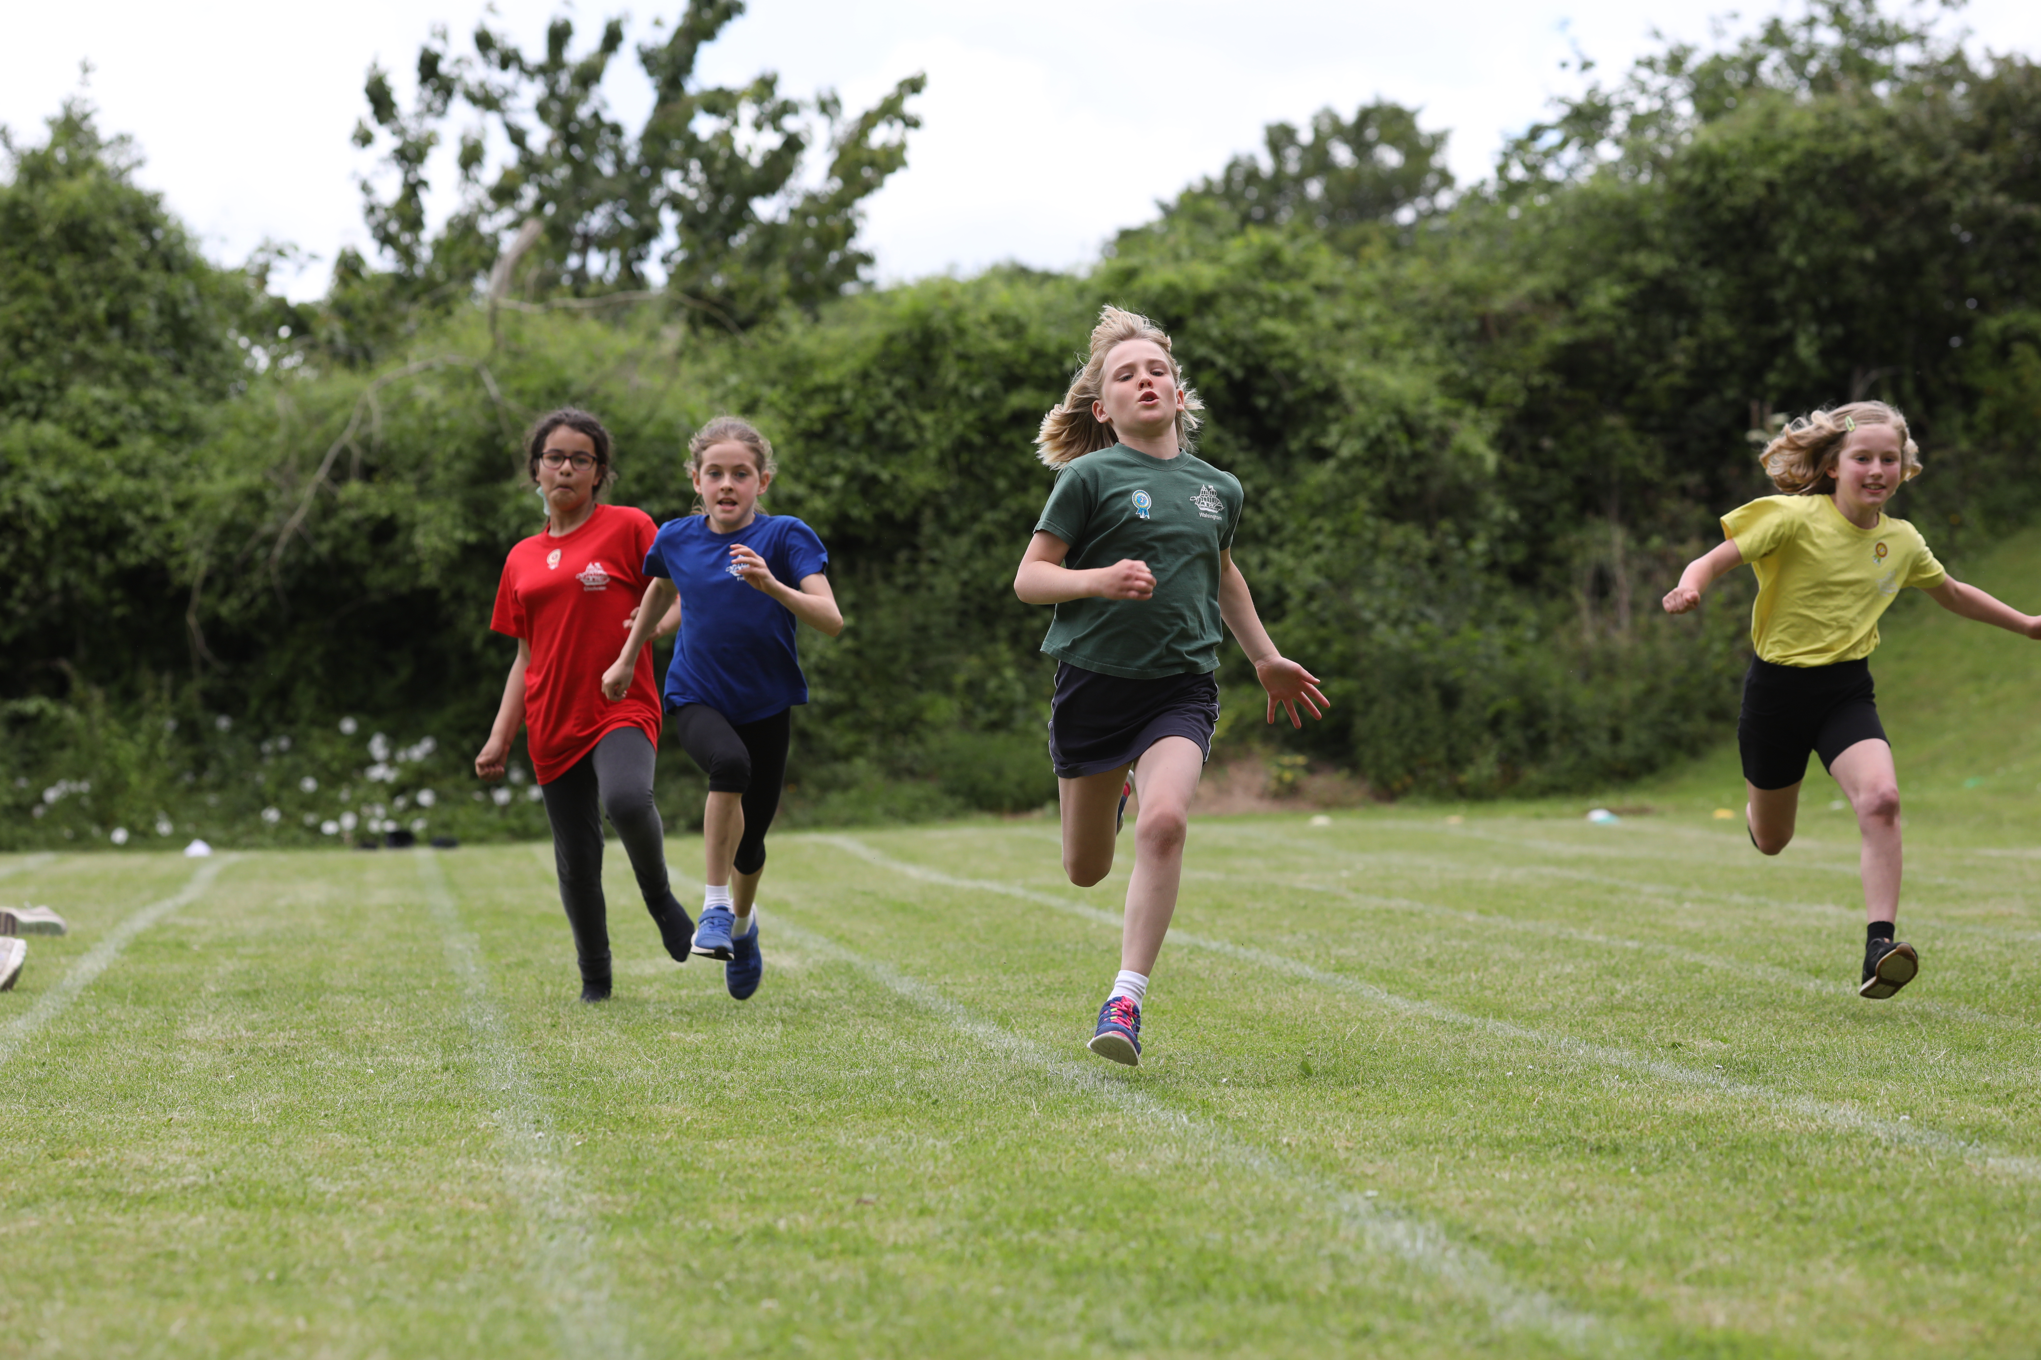
Marlborough School
Starting at Marlborough…
PE kit
Children will need a PE kit, with their names on each item of clothing. This consists of a Packet Ship t-shirt and black shorts.
Children will not need swimming costumes yet.
Please can children have labelled wellies in school.
https://marlborough.eschools.co.uk/website/dress_code/465790

Slide 9
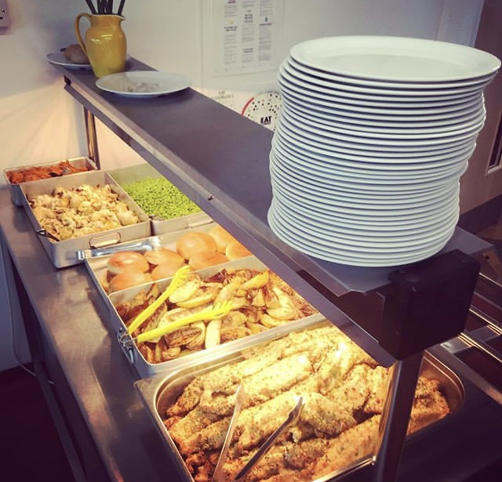
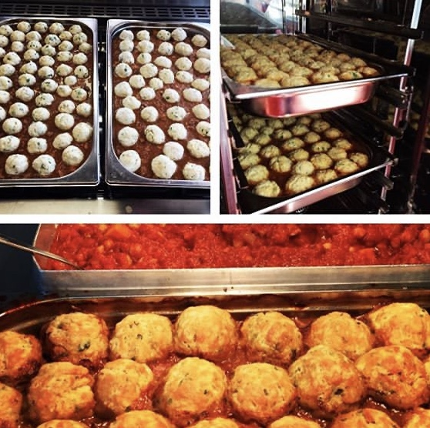
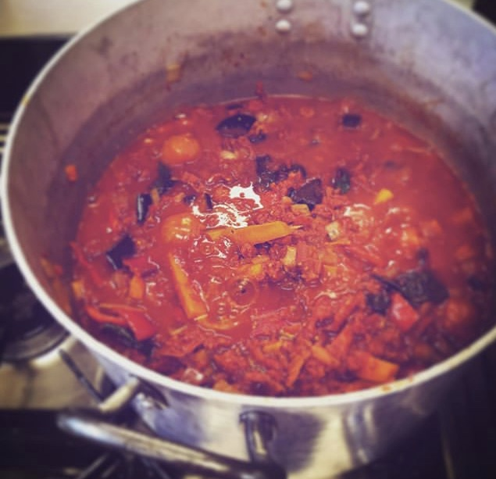
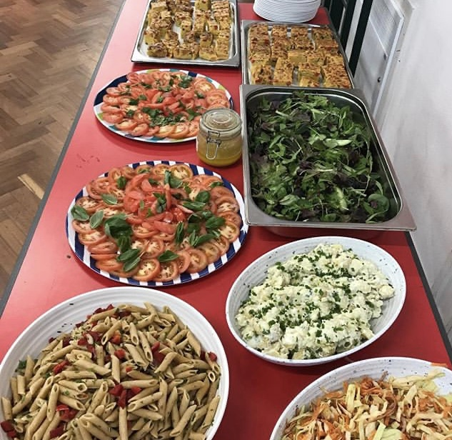
Marlborough School
Starting at Marlborough…
Universal Free School Meals for Infants
All of the children in Reception, Year 1 and Year 2 have delicious school lunches provided free of charge.
They are able to make their lunch choices each morning.
Children eat in the school hall at round tables, using knives and forks and with adults supervising them.
Our kitchen can cater for individual dietary needs, just talk to Mrs Pearce or Mrs Prason before your child starts school.

Slide 10
Marlborough School
Last term’s menu

Slide 11
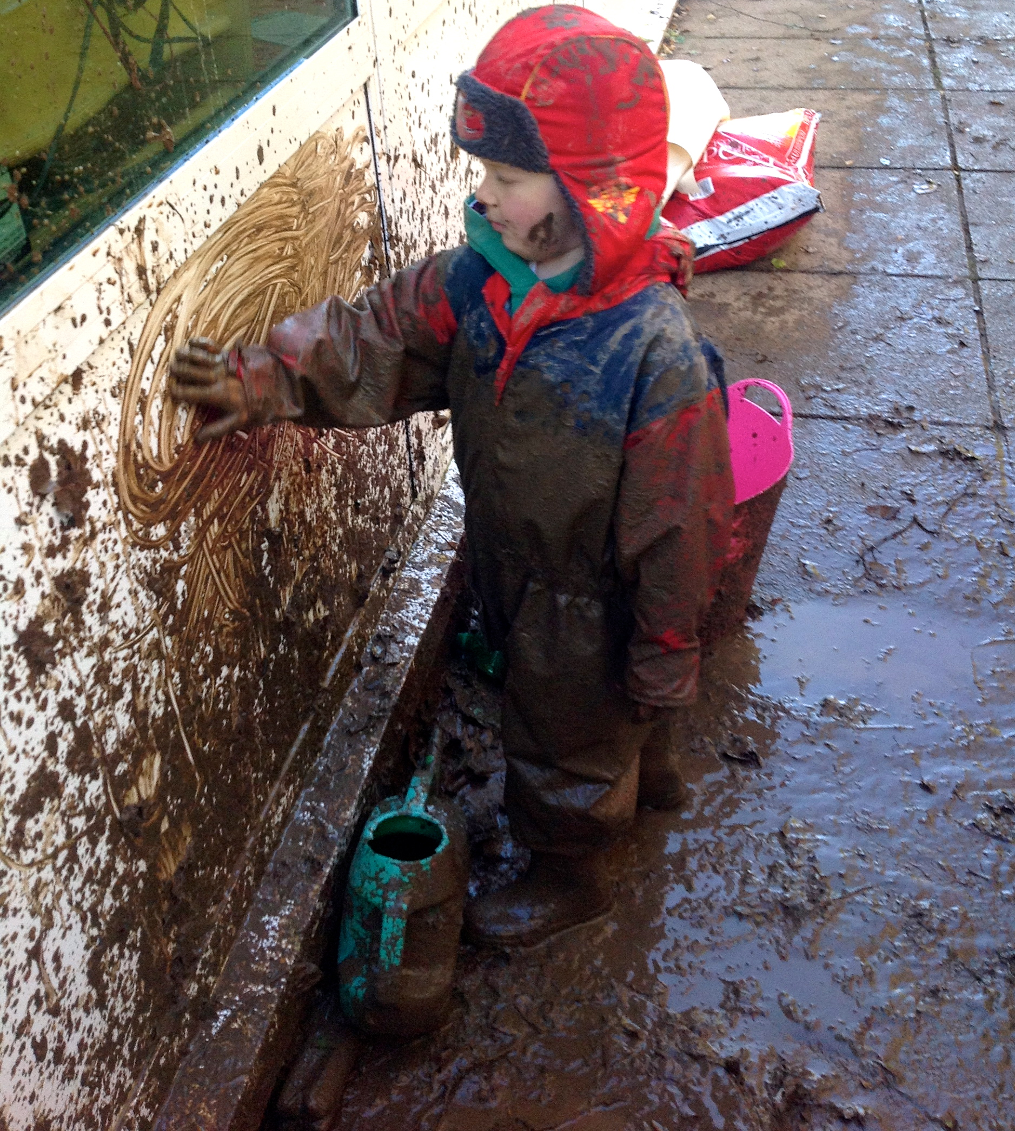
Marlborough School
Starting at Marlborough…
Practical Personal Skills
It is really important that your children becomes independent with many aspects of school life. In order to support them with this it would be helpful if children were able to use a knife and fork, get themselves dressed and undressed for PE and be independent when going to the toilet.
If you have any worries about this aspect of starting school please talk to Mrs Pearce or Mrs Prason.

Slide 12
Marlborough School
Timings
Aspects of school life are going to be different due to Covid-19 and there are many precautions we will have to put into place for September.
The classroom door will be open from 8.30 until 8.45; we will give you more information on dropping your children off nearer the time as we receive the safety updates.
Lunch for the reception children will be at 12pm.
The school day ends at 3.20pm. On Fridays school finishes at 2pm.
Parents wait at a distance from the classroom door for their child to come out.

Slide 13
Marlborough School
Transition
In order to settle the children in to school life we will have transition sessions, where children start in smaller groups during the first two weeks of September.
 | Monday 7th Sept | Tuesday 8th Sept | Wed 9th Sept | Thurs 10th Sept | Friday 11th Sept | Monday 14th Sept | Tuesday 15th Sept | Wed 16th Sept | Thurs 17th Sept | Friday 18th Sept | Monday 21st Sept
Morning Session 8.30-11am | Swiftsure Walsingham Fox | Swiftsure Walsingham Fox | Swiftsure Walsingham Fox | Swiftsure Walsingham Fox | Swiftsure Walsingham Fox | Chichester Pelham Freeling | Chichester Pelham Freeling | Chichester Pelham Freeling | All children- 12pm pick up | All children stay for the morning and can choose to stay for lunch- 1pm pick up | All children full time
Afternoon Session 12.50-3.20 | Chichester Pelham Freeling | Chichester Pelham Freeling | Chichester Pelham Freeling | Chichester Pelham Freeling | Chichester Pelham Freeling | Swiftsure Walsingham Fox | Swiftsure Walsingham Fox | Swiftsure Walsingham Fox

Slide 14
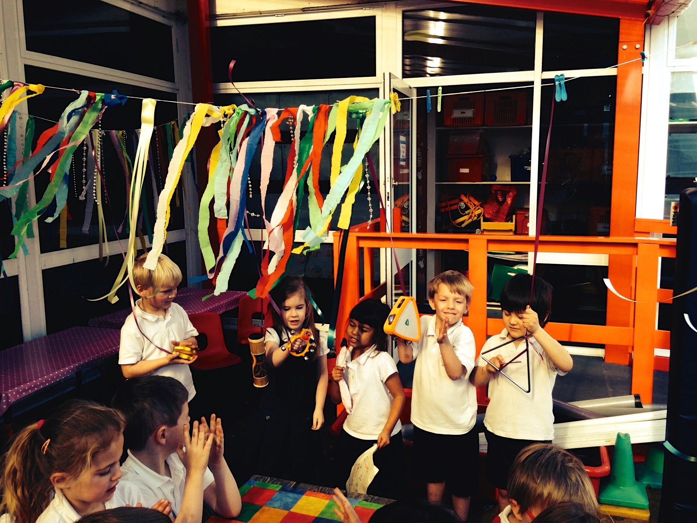
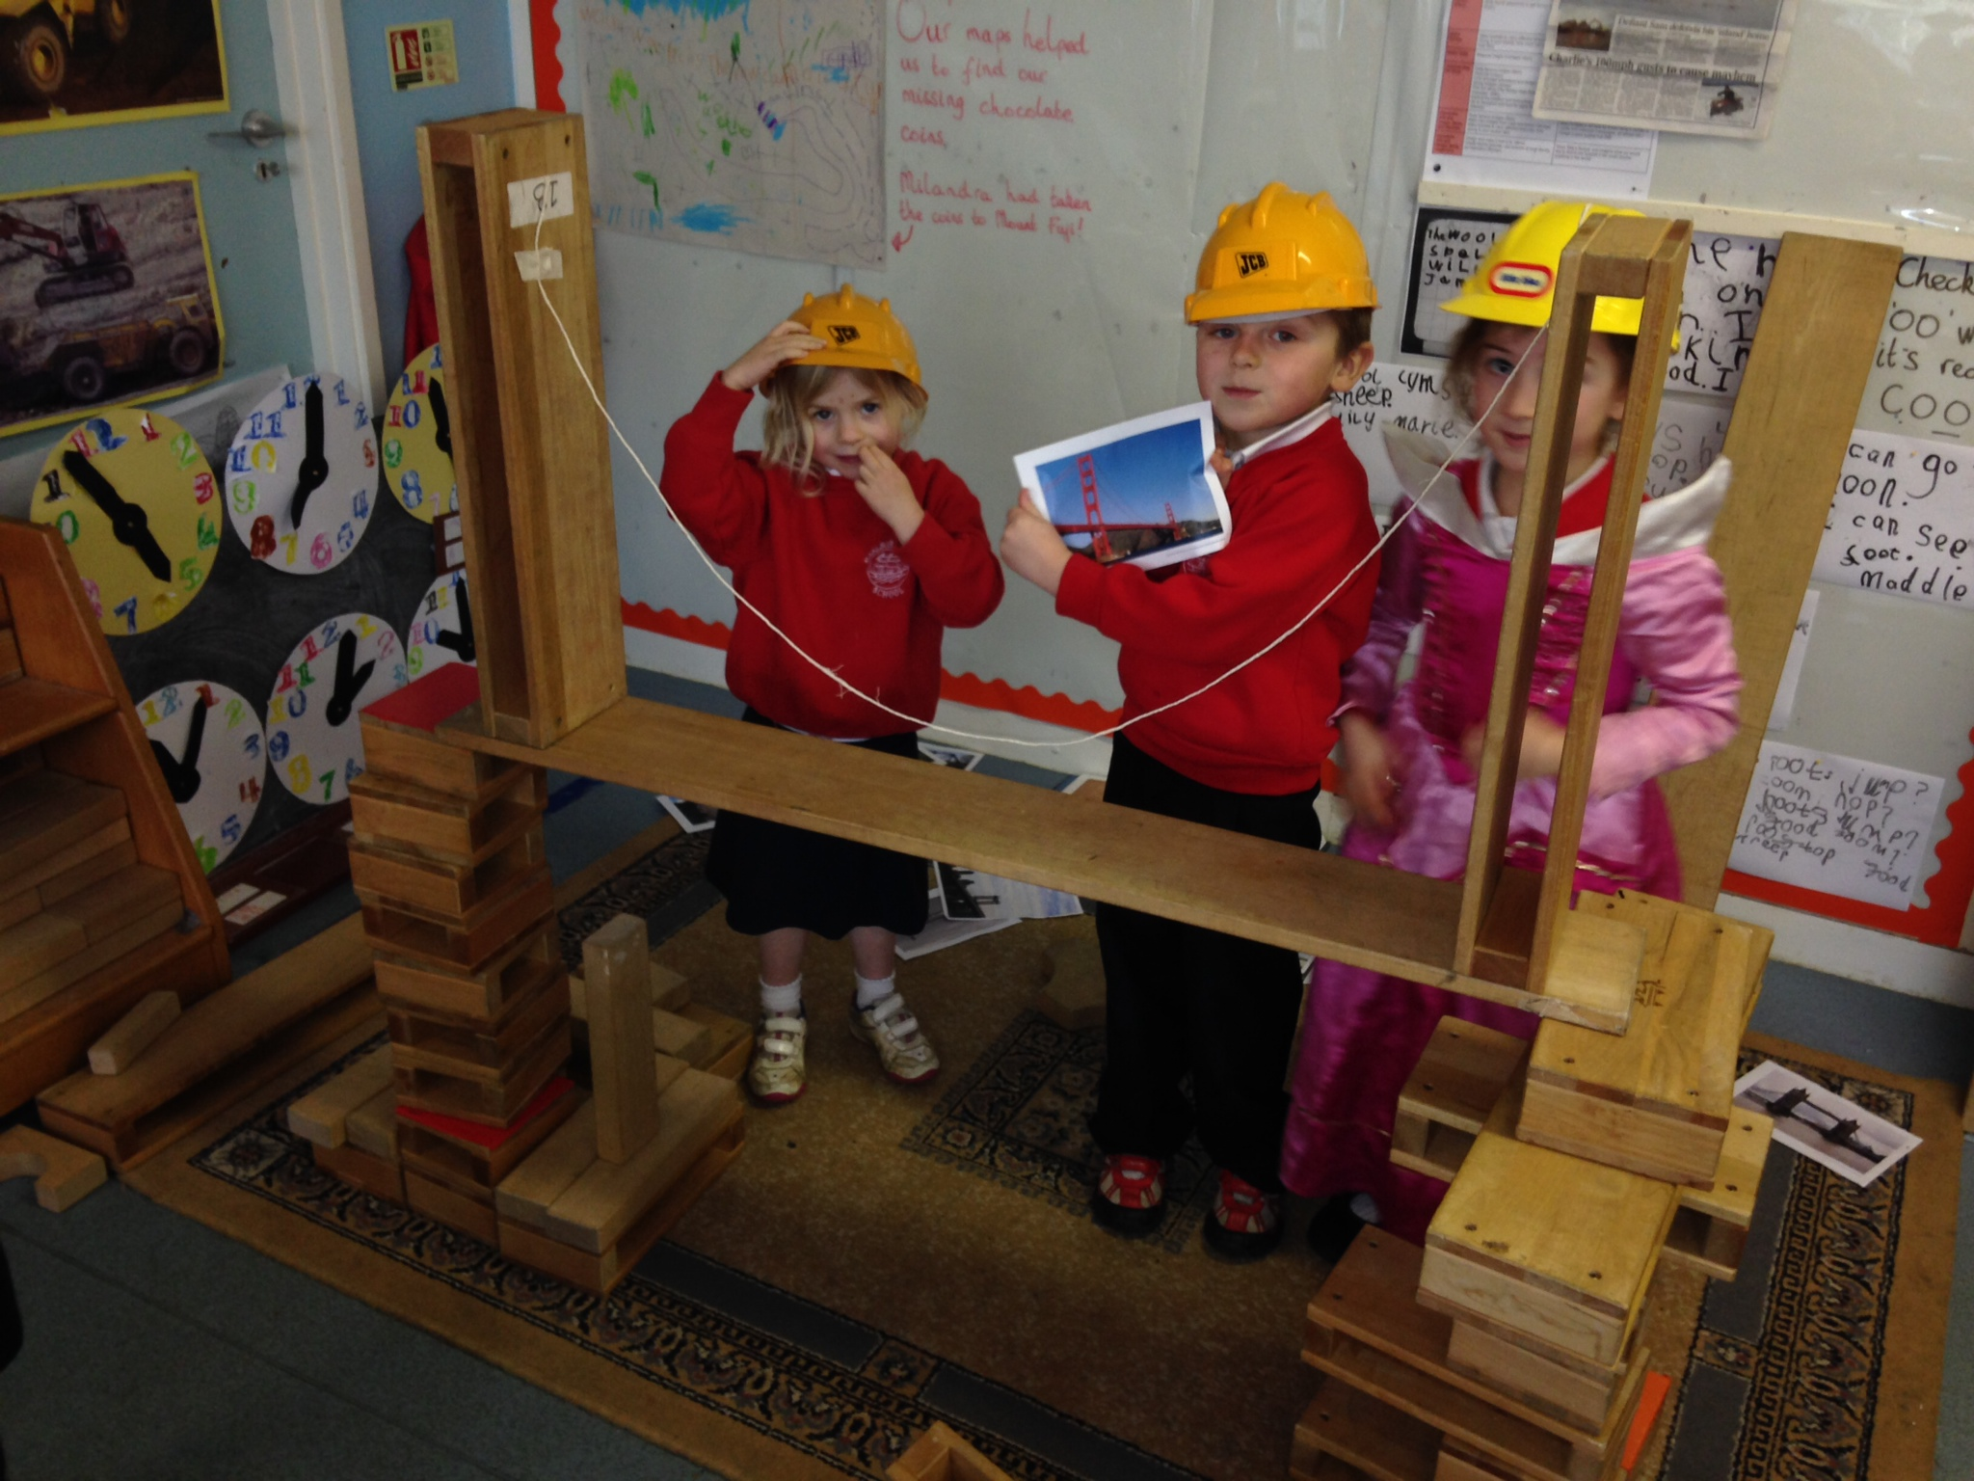
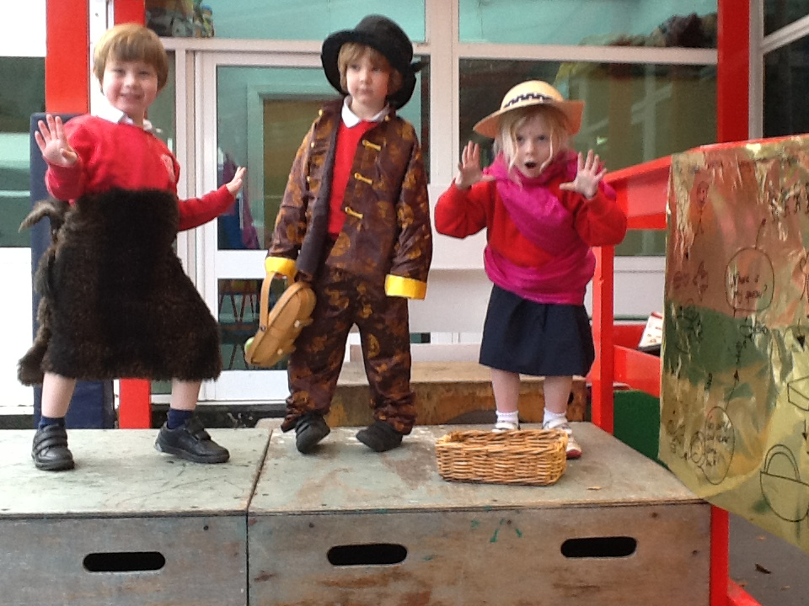
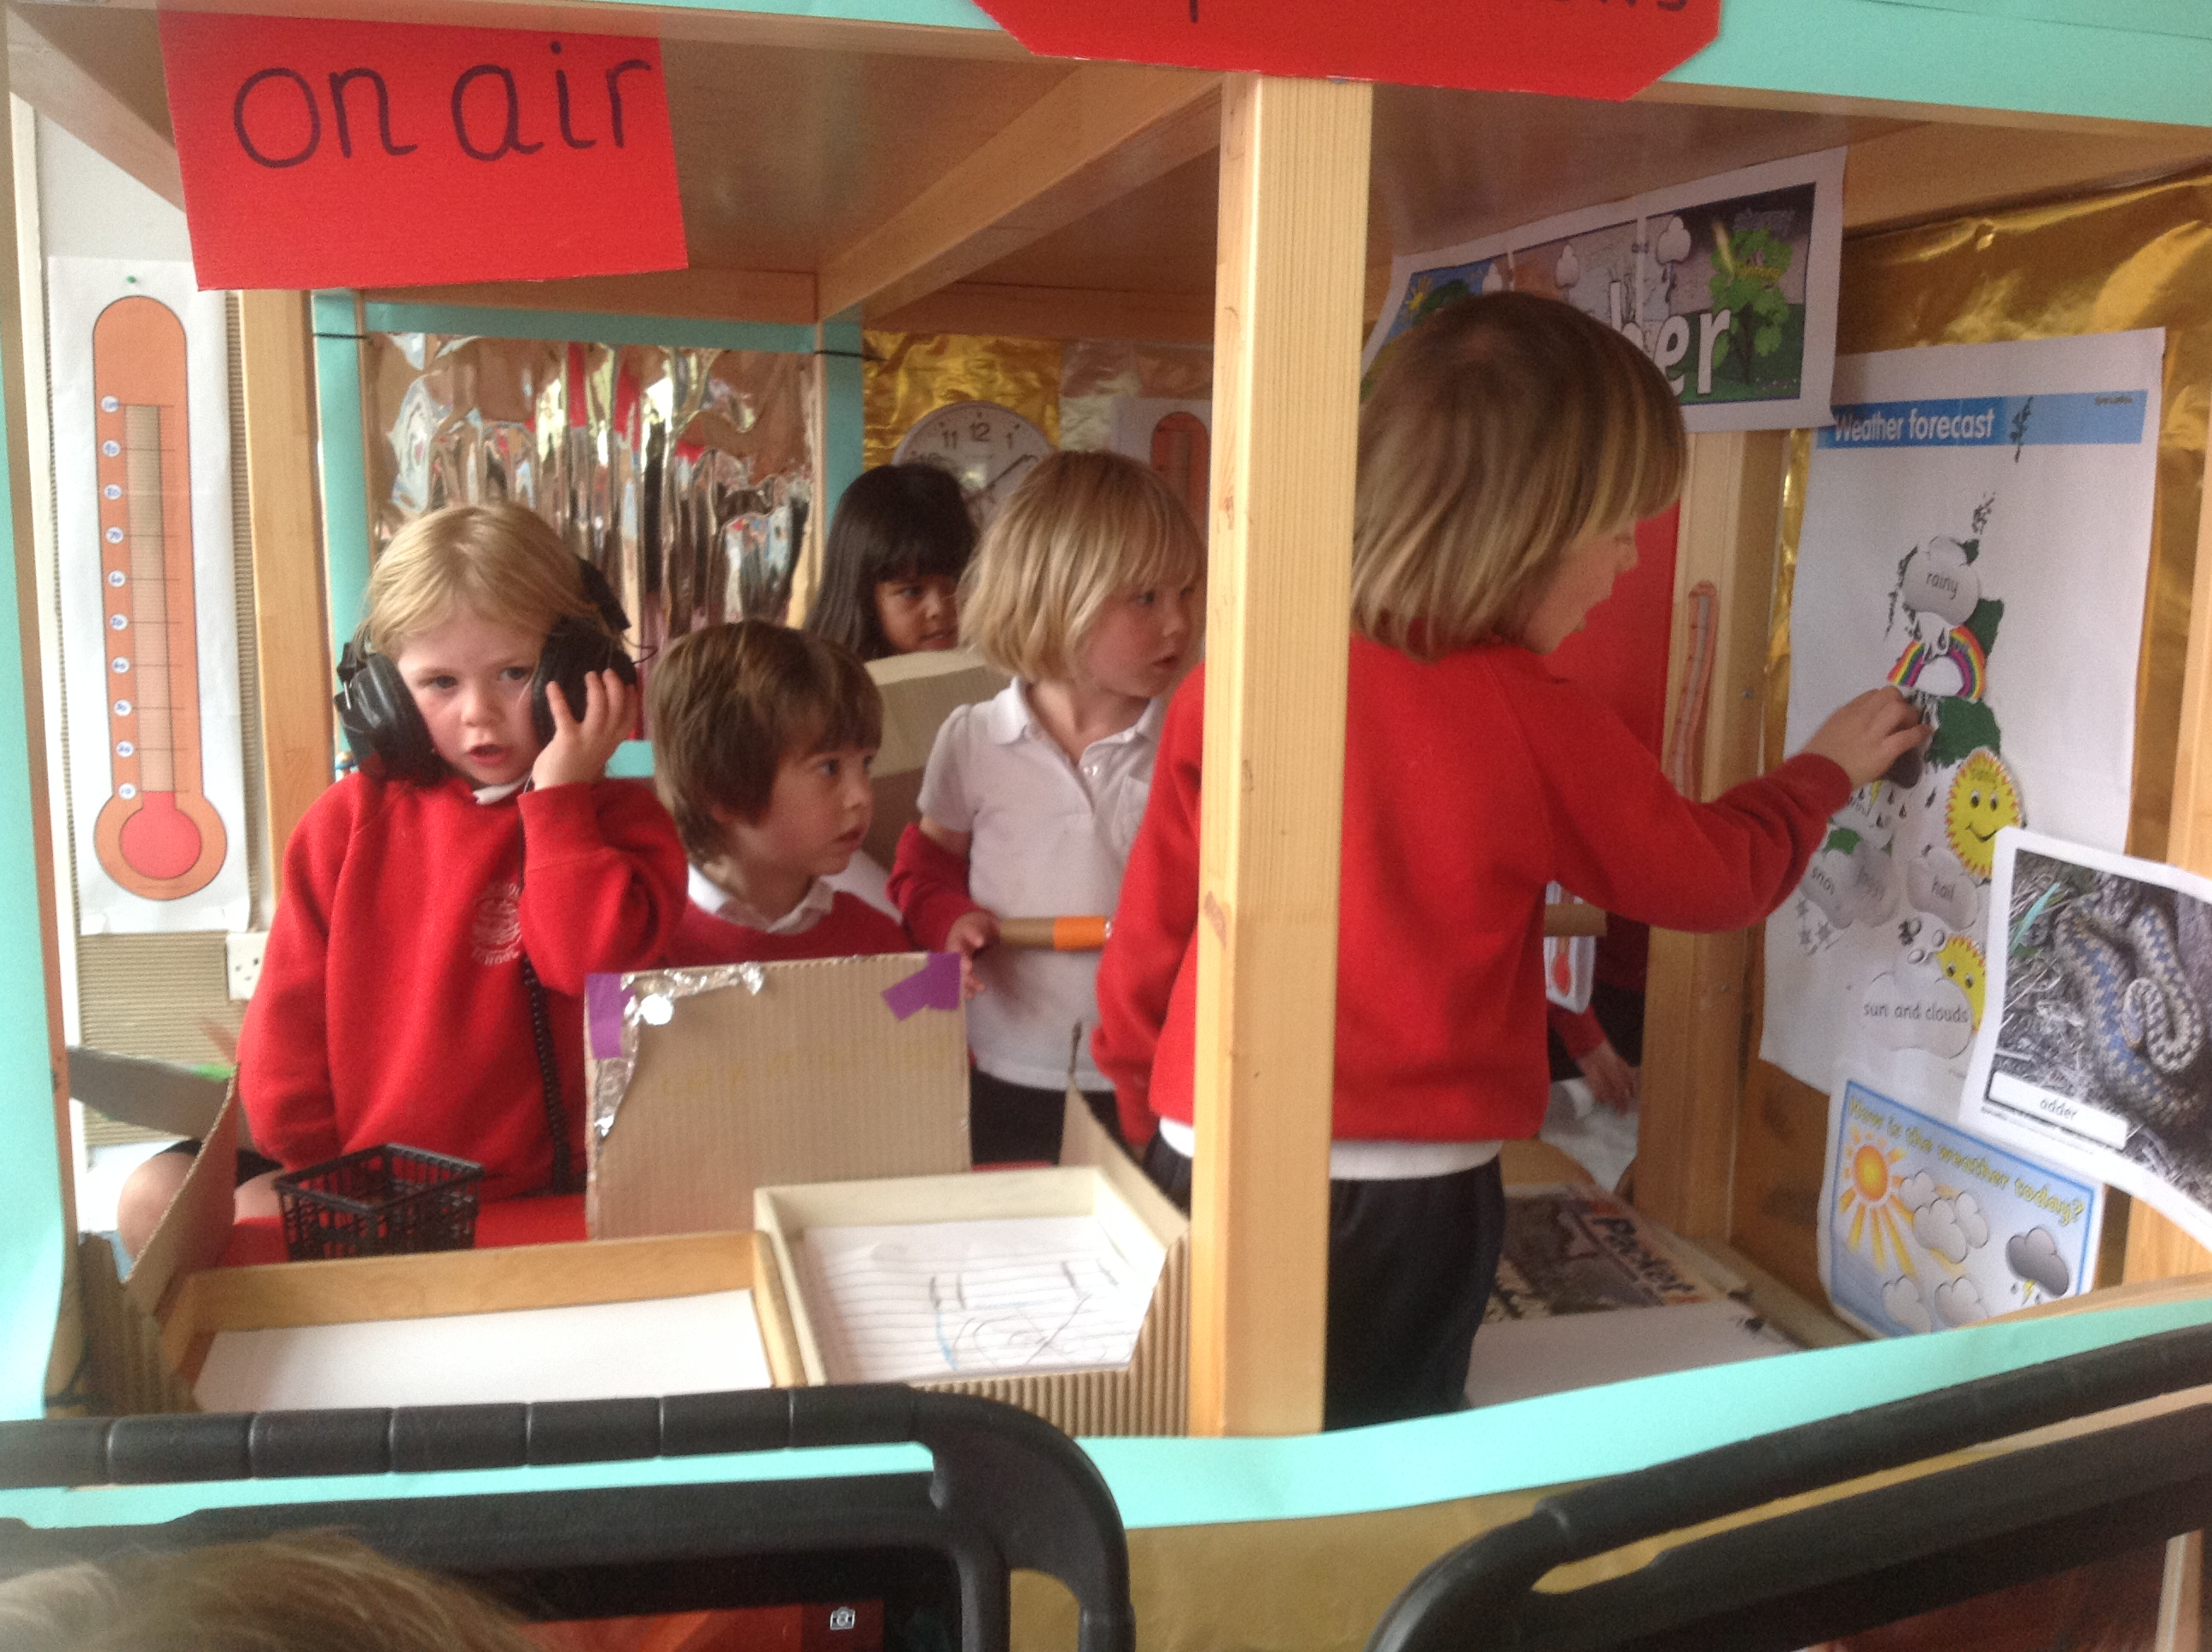
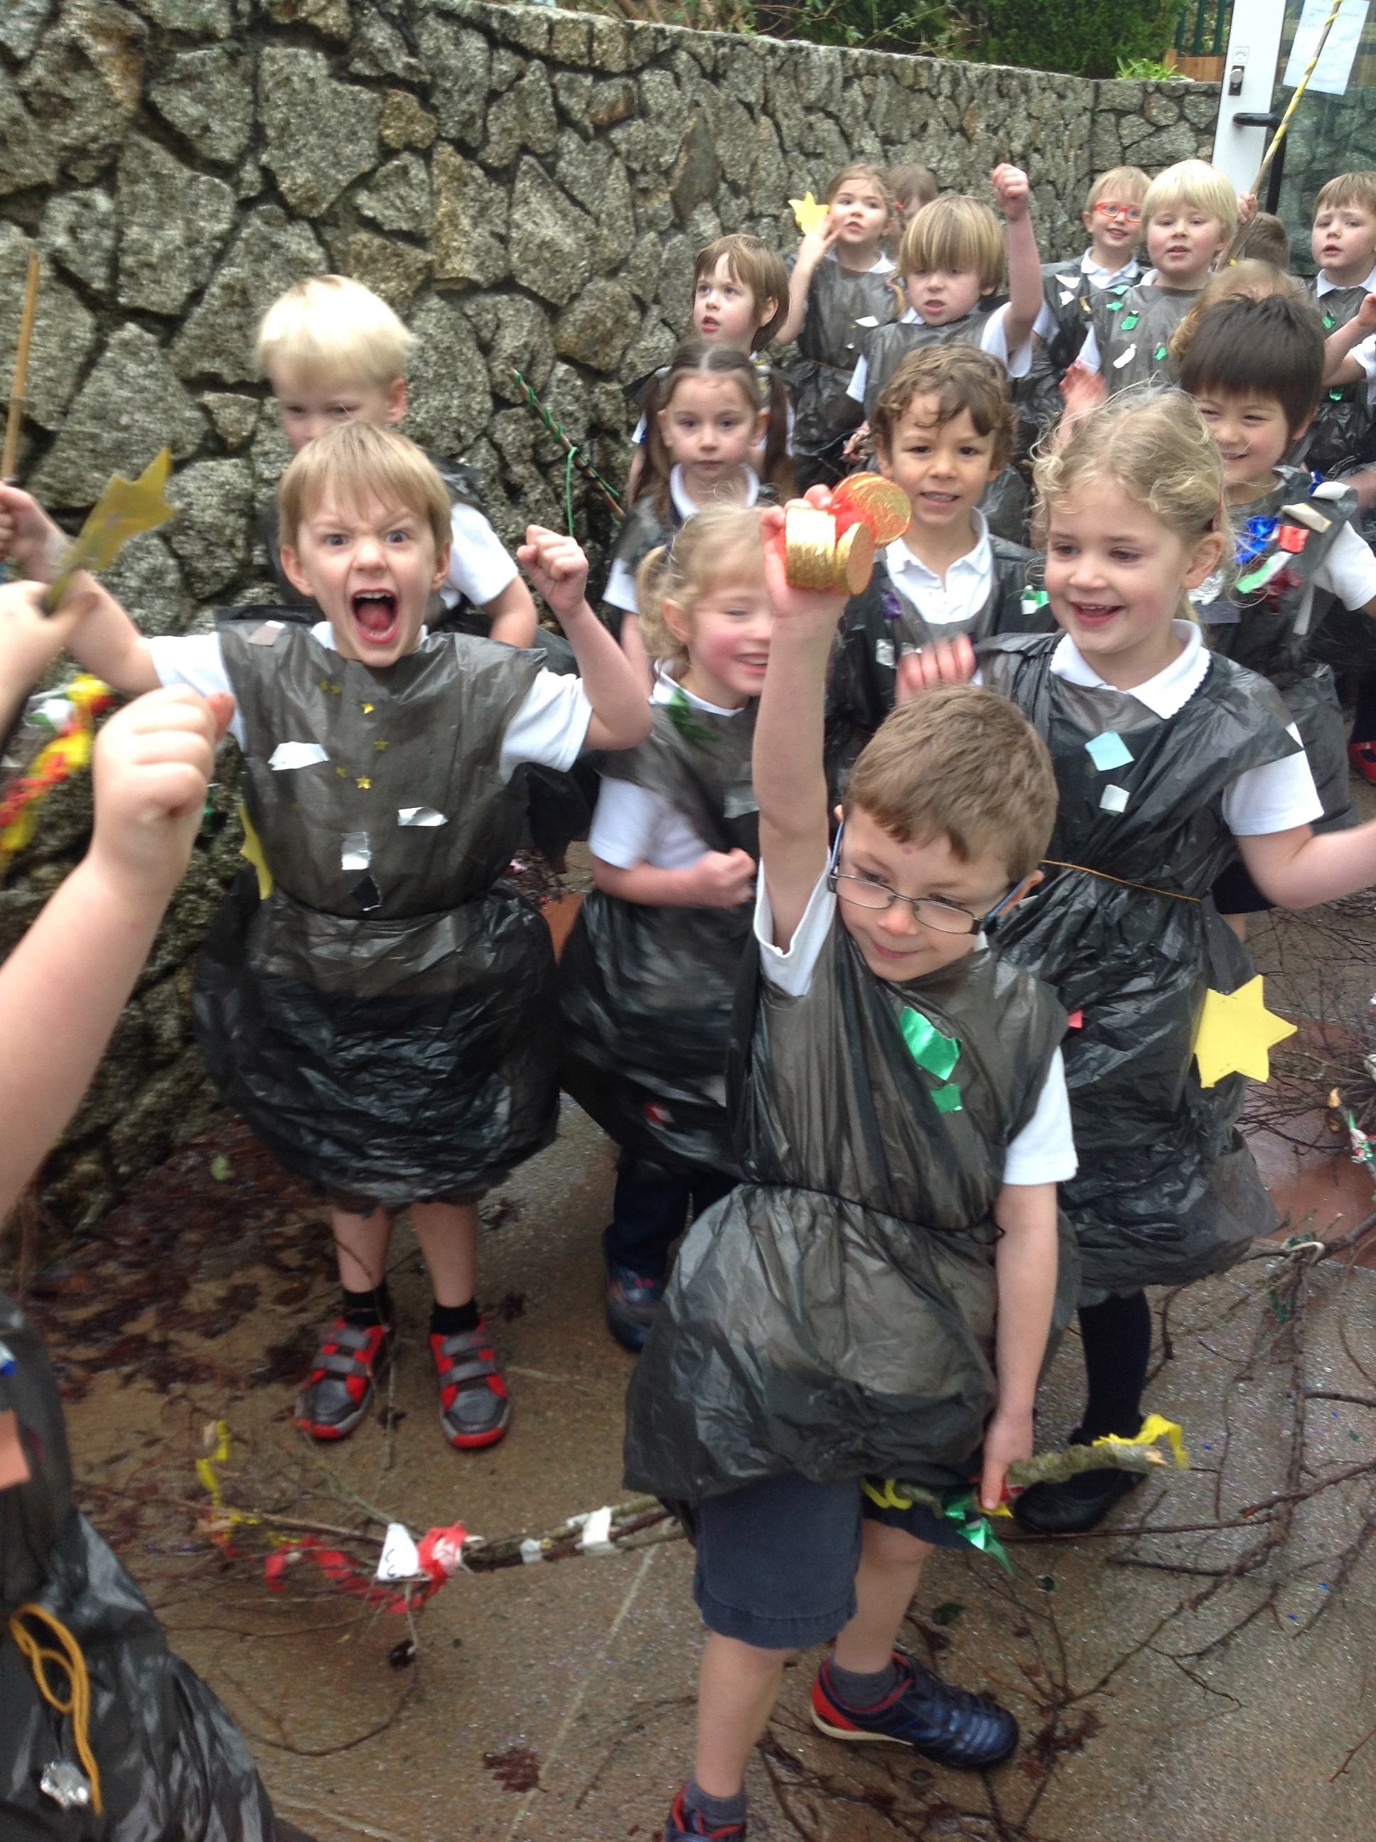
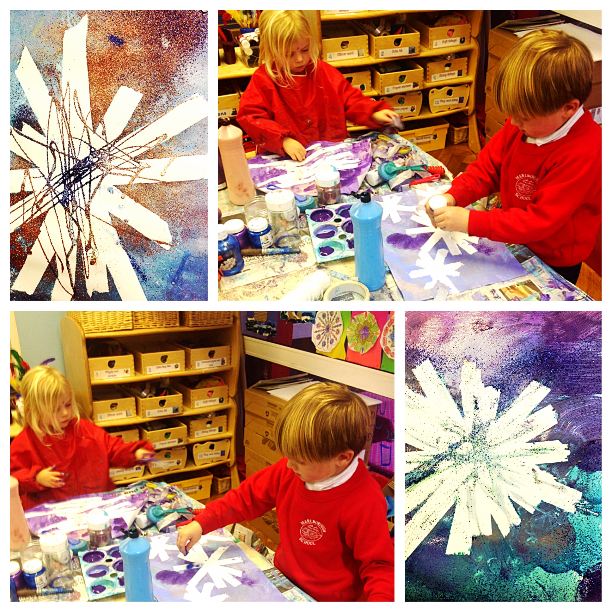
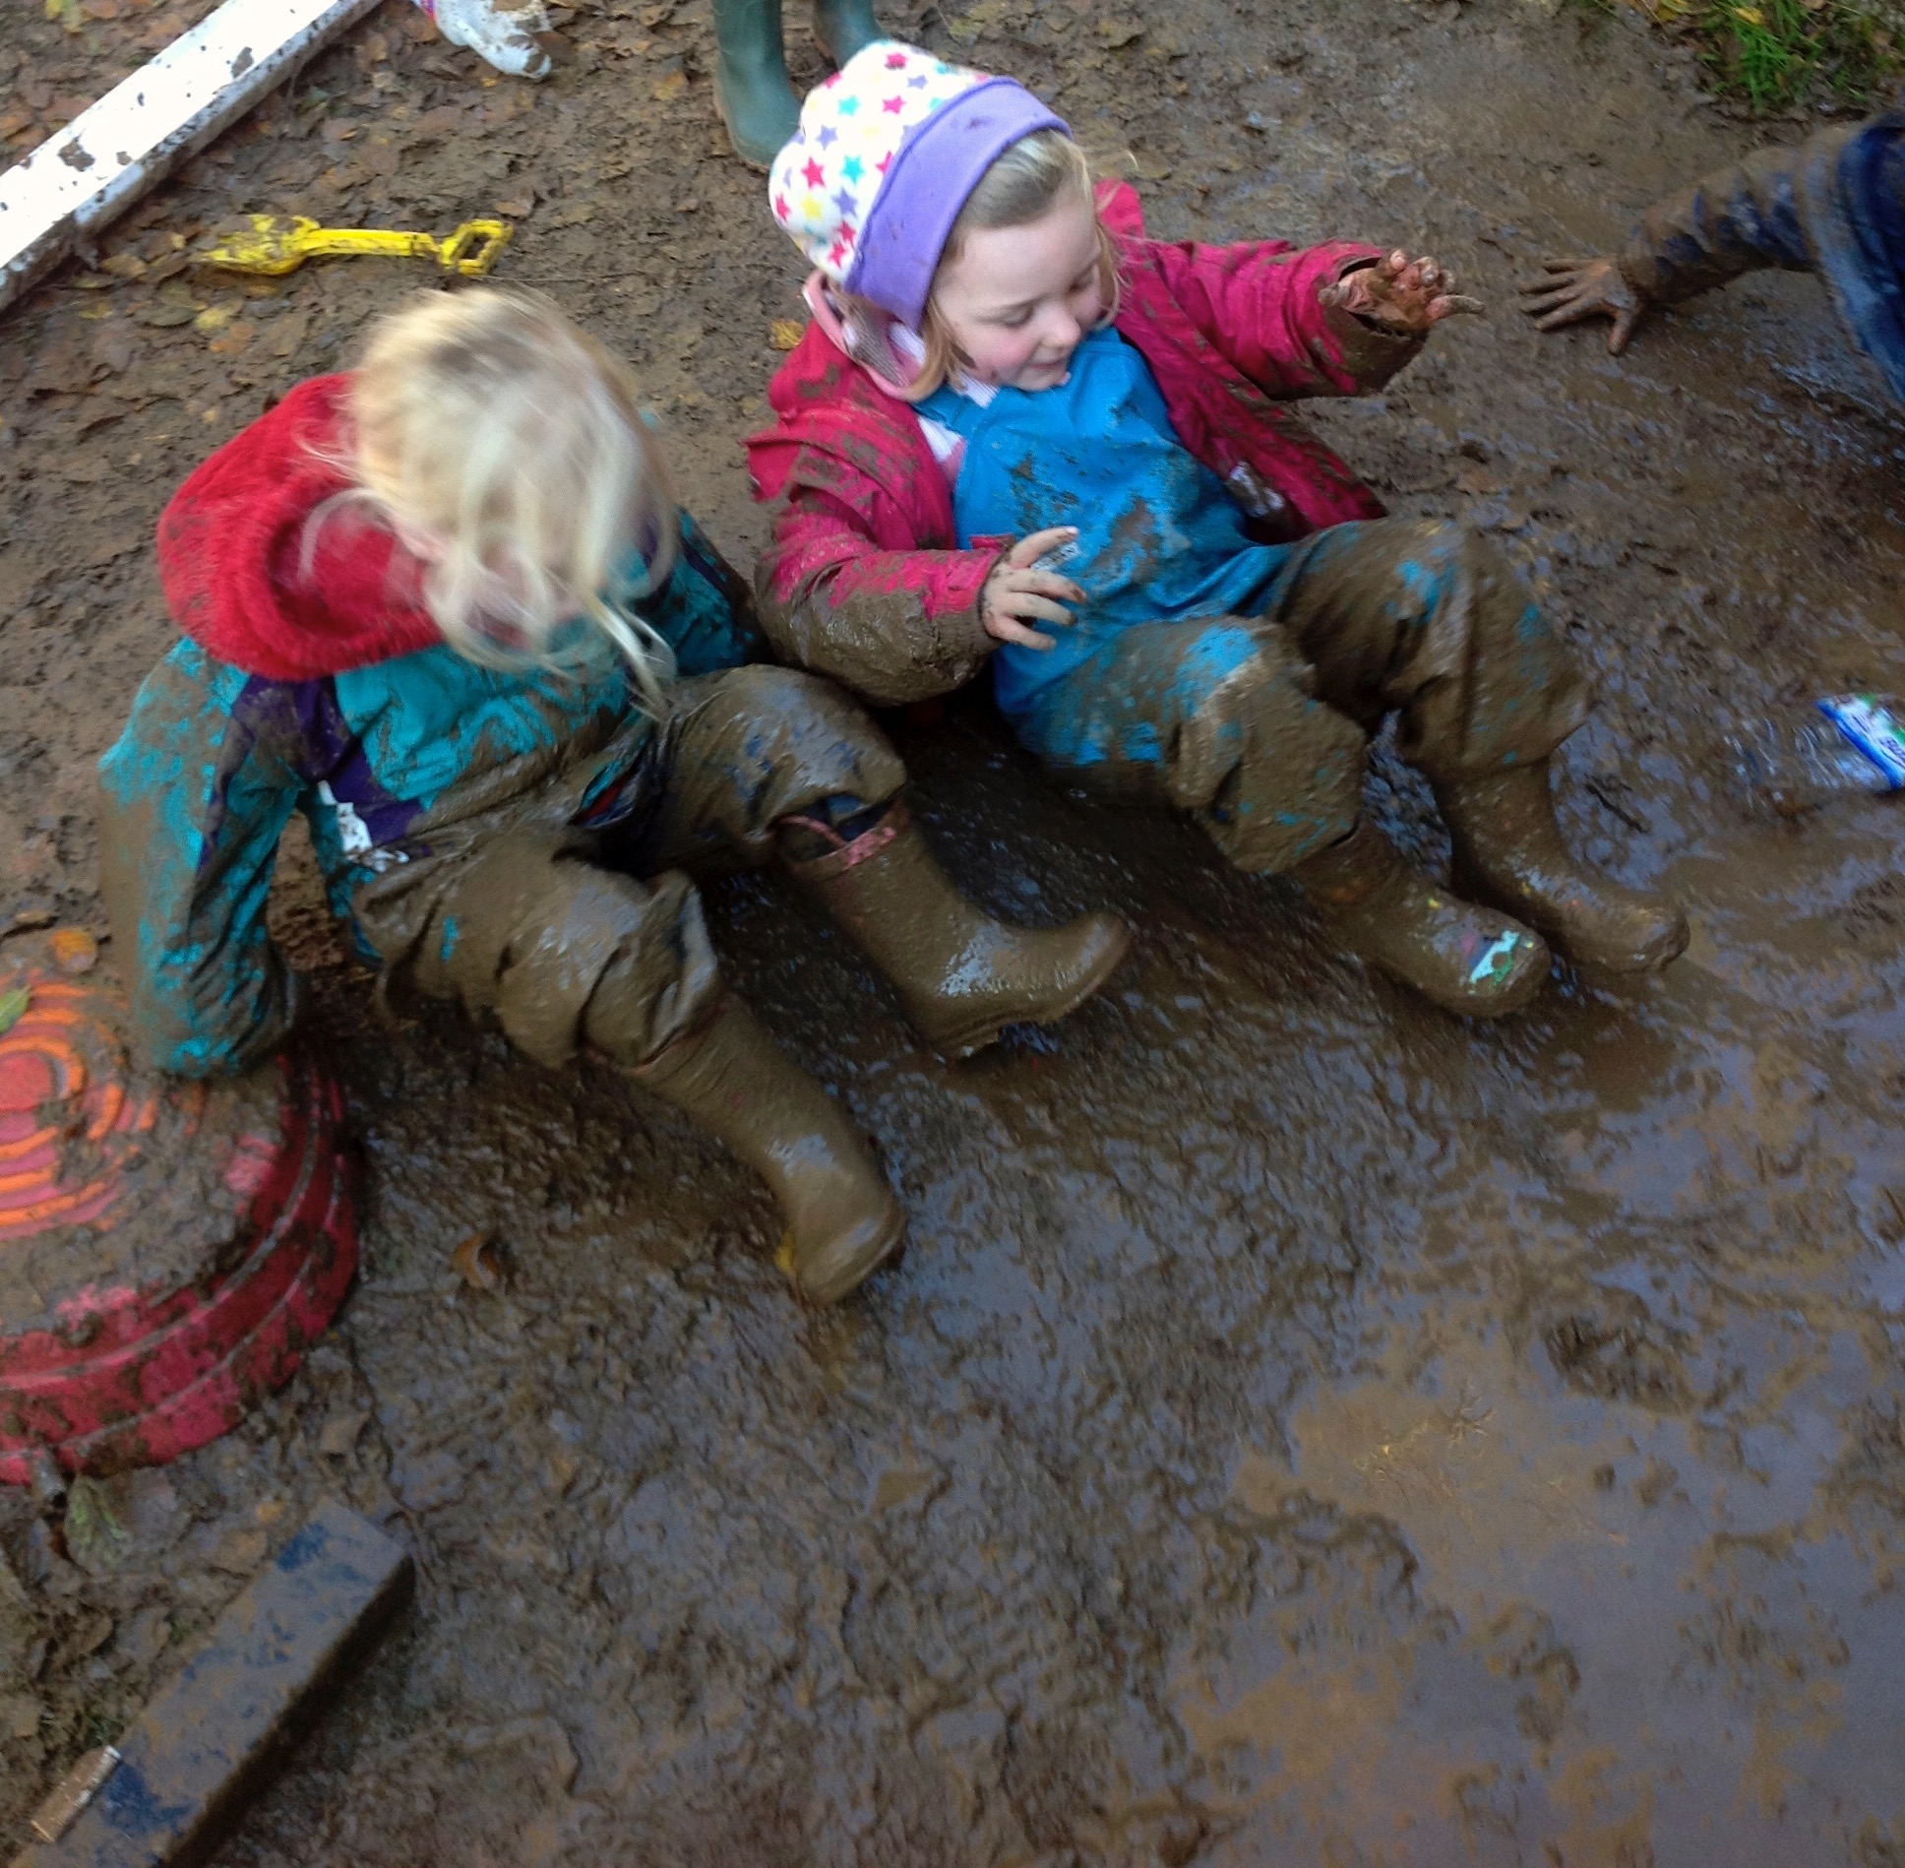
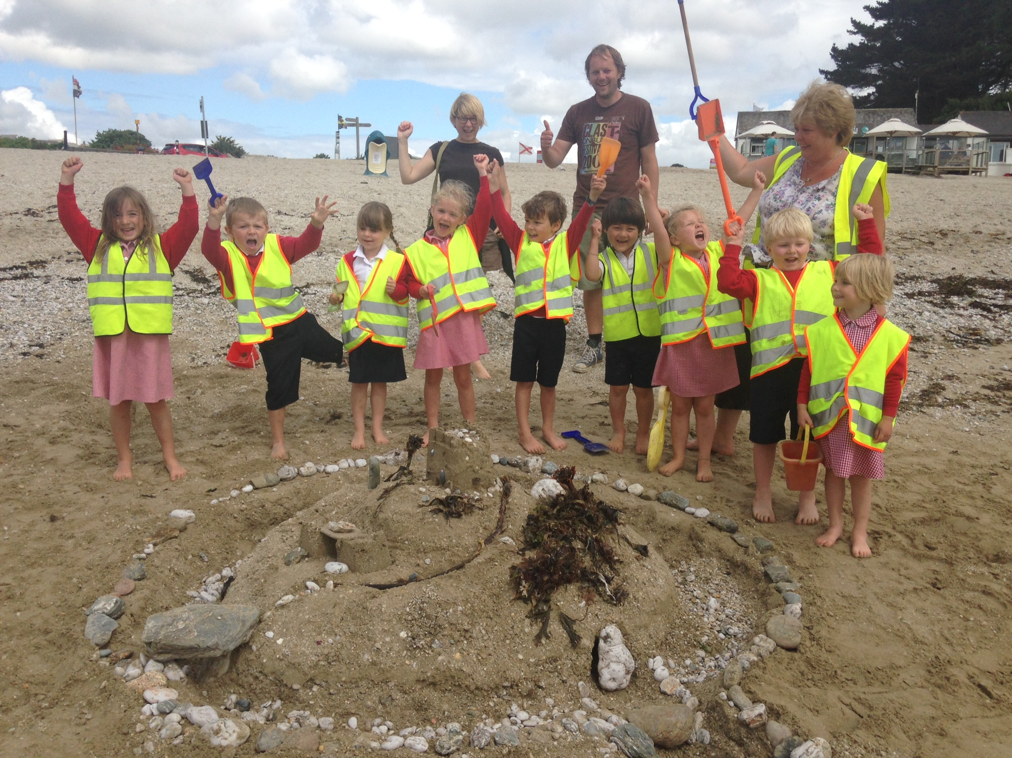
Marlborough School
What is it like to be in Reception Class at Marlborough School?
https://vimeo.com/68252354
https://vimeo.com/127502097
Notes:
https://vimeo.com/68252354

Slide 15
Marlborough School
Have a look at our school website for newsletters, information, updates and policies.
https://marlborough.eschools.co.uk/website
Notes:
https://vimeo.com/68252354

Slide 16
Marlborough School
A Rising Tide Lifts All Ships
We’re looking forward to seeing you!

